Slide 1
ICT FOR Senior 5
Facilitator Name :Augustin NSENGIYUMVA

Slide 2
Course content
Unit 1: ADVANCED SPREADSHEET
UNIT 2: ADVANCED POWER POINT
UNIT 3: COMPUTER GRAPHICS TOOLS
UNIT 4: E COMMERCE, SOCIAL MEDIA AND ONLINE SERVICES
UNIT 5: DATABASE basics

Slide 3
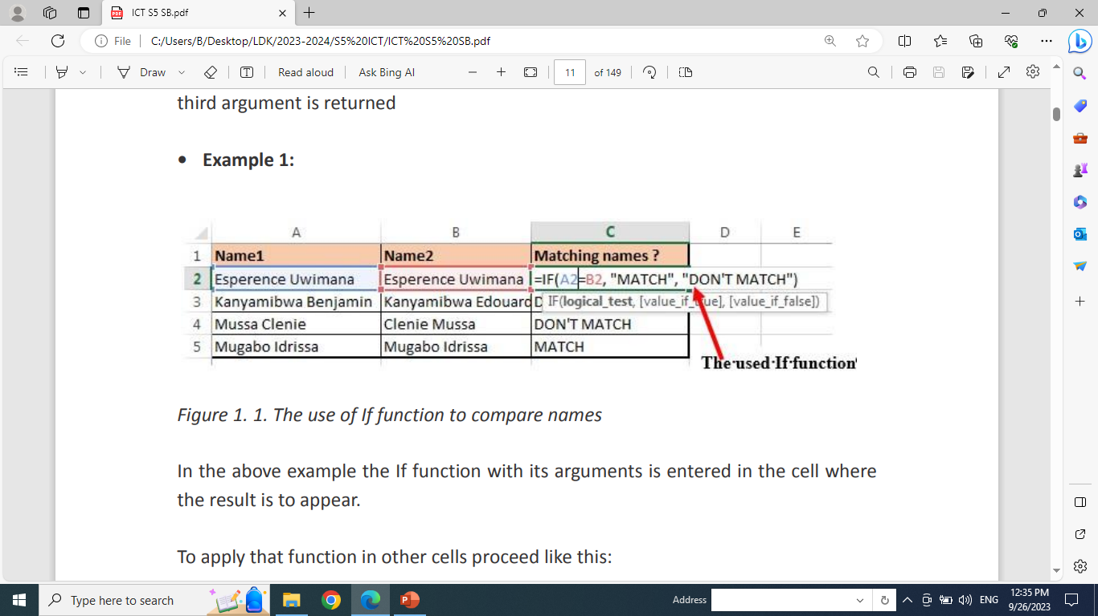
Unit 1: ADVANCED SPREADSHEET
1.1. Advanced Spreadsheet functions
1.1.1. Logical functions
The role of these functions is to check whether a condition is true or false.
It can combine multiple conditions together and comes up with a result depending on the result of the evaluation of the condition.
a. IF Function
The If function checks whether data in a cell meets a certain condition and returns one value which can be True or False
Syntax: = IF(Logical_test, Value_If_True, Value_If_False )

Slide 4
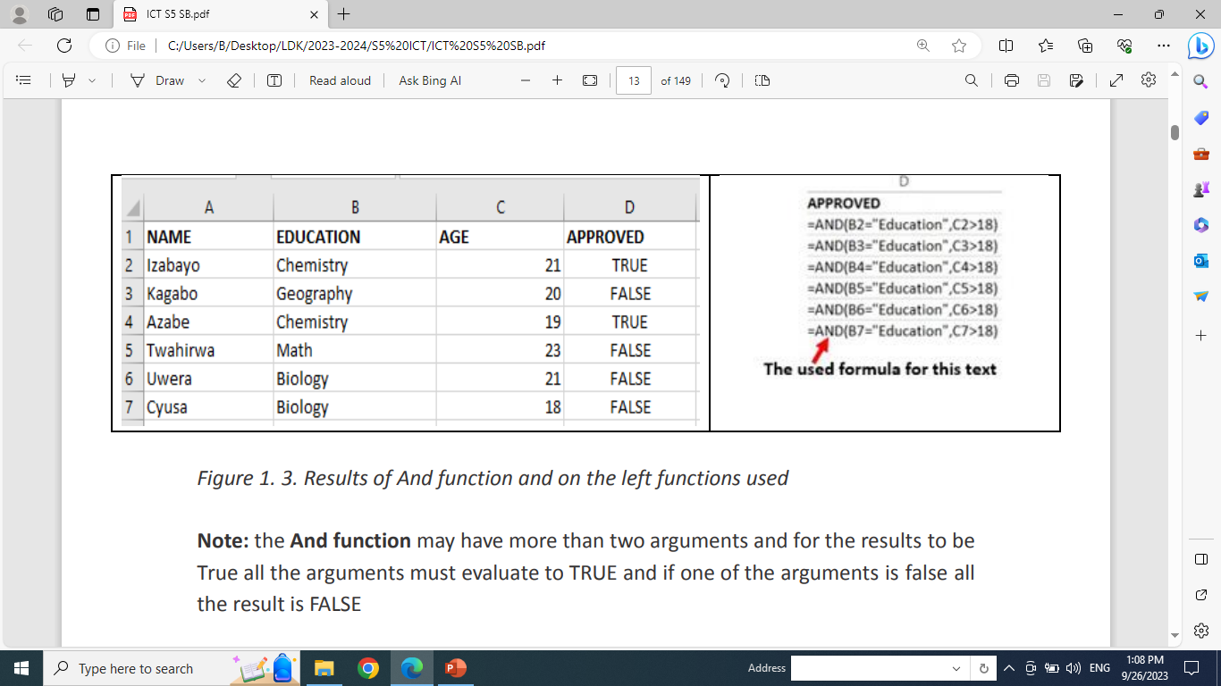
b. AND Function
The Excel AND function is a logical function used to test if two or many conditions are true.
The result is TRUE if all the conditions are true else the result is FALSE
Syntax: =AND (Logical1, Logical2, logical3,..).

Slide 5
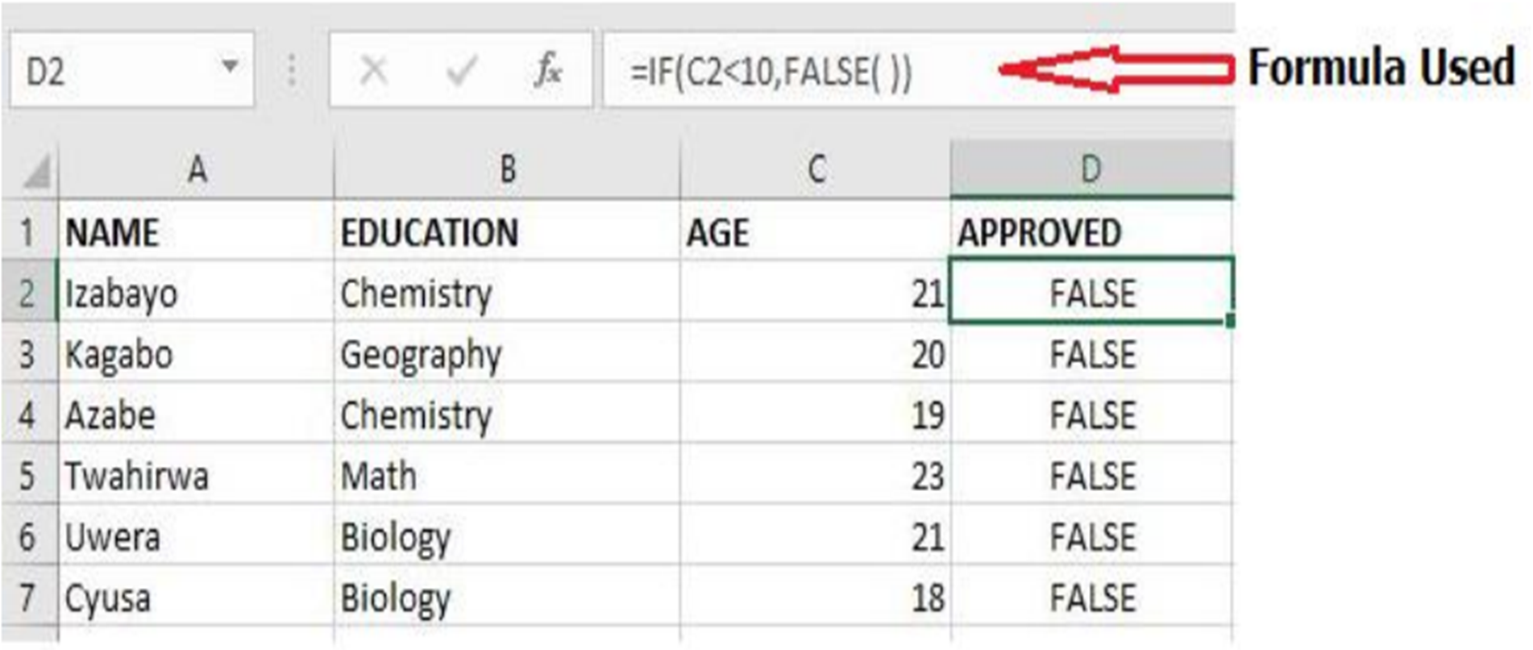
C. FALSE Function
The FALSE function takes no arguments and generates the Boolean value FALSE.
It is used to compare the results of a condition or function that either returns true or false
Syntax: =False ( )
Example: The False function used in the example below returns FALSE if the age entered in C2 is less than 20 (C2<10).

Slide 6
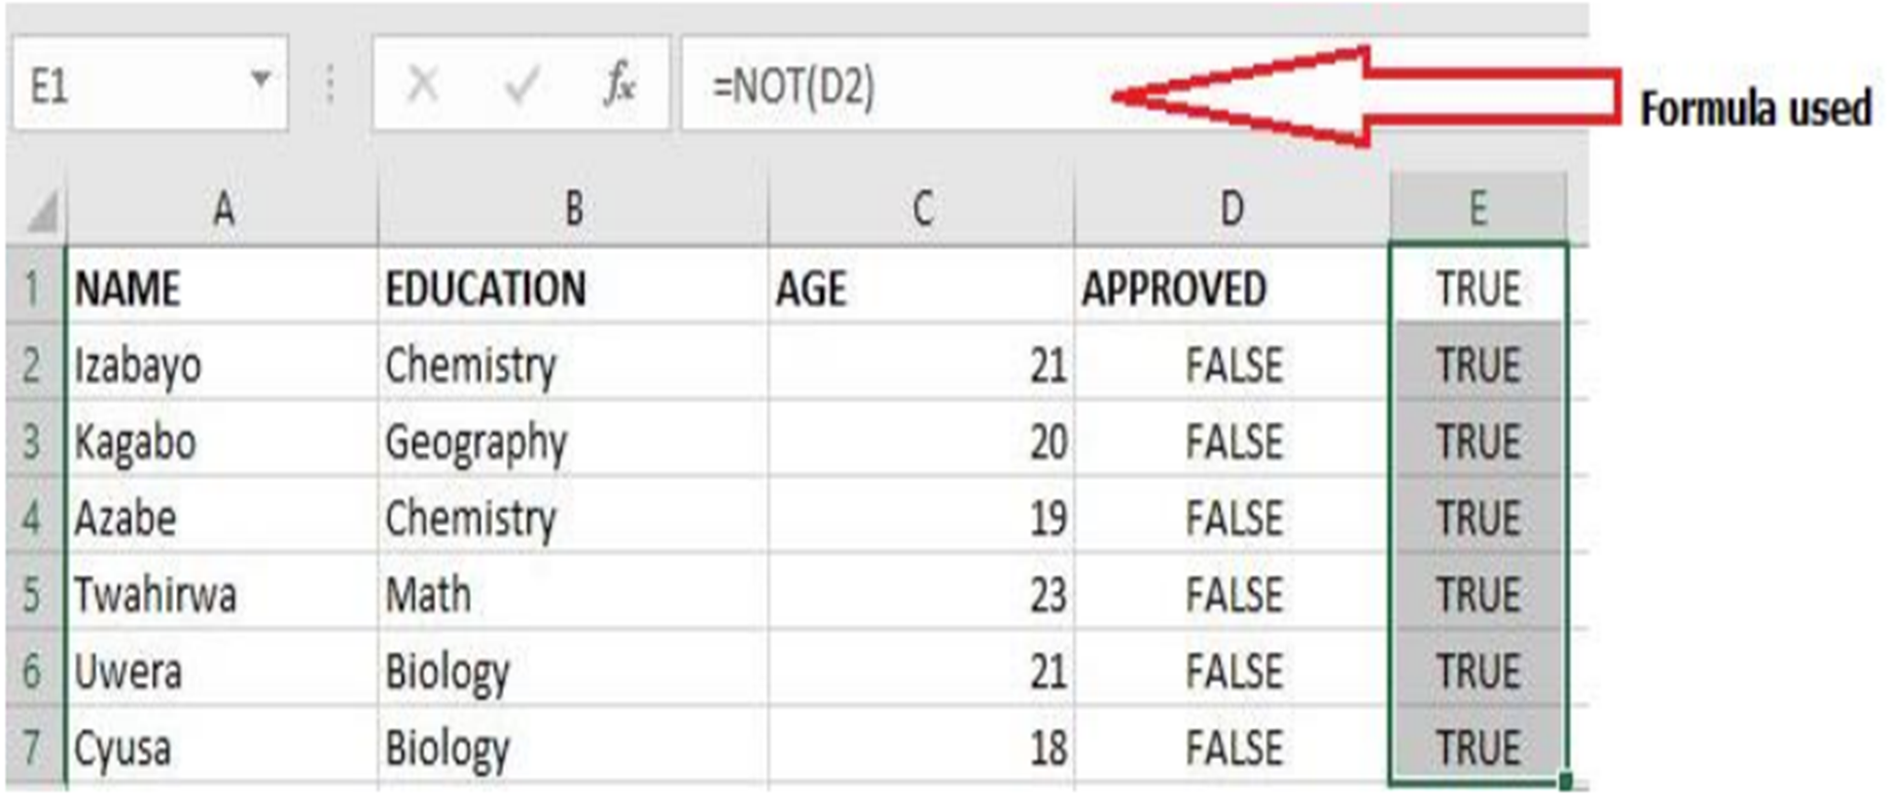
D. NOT Function
The Excel NOT function returns the opposite of a given logical or Boolean value.
When given TRUE, NOT returns FALSE.
When given FALSE, NOT returns TRUE.
Use the NOT function to reverse a logical value.
Syntax: =NOT(Logical)
Example The table below will have all its content returned to True by the use the NOT function.

Slide 7
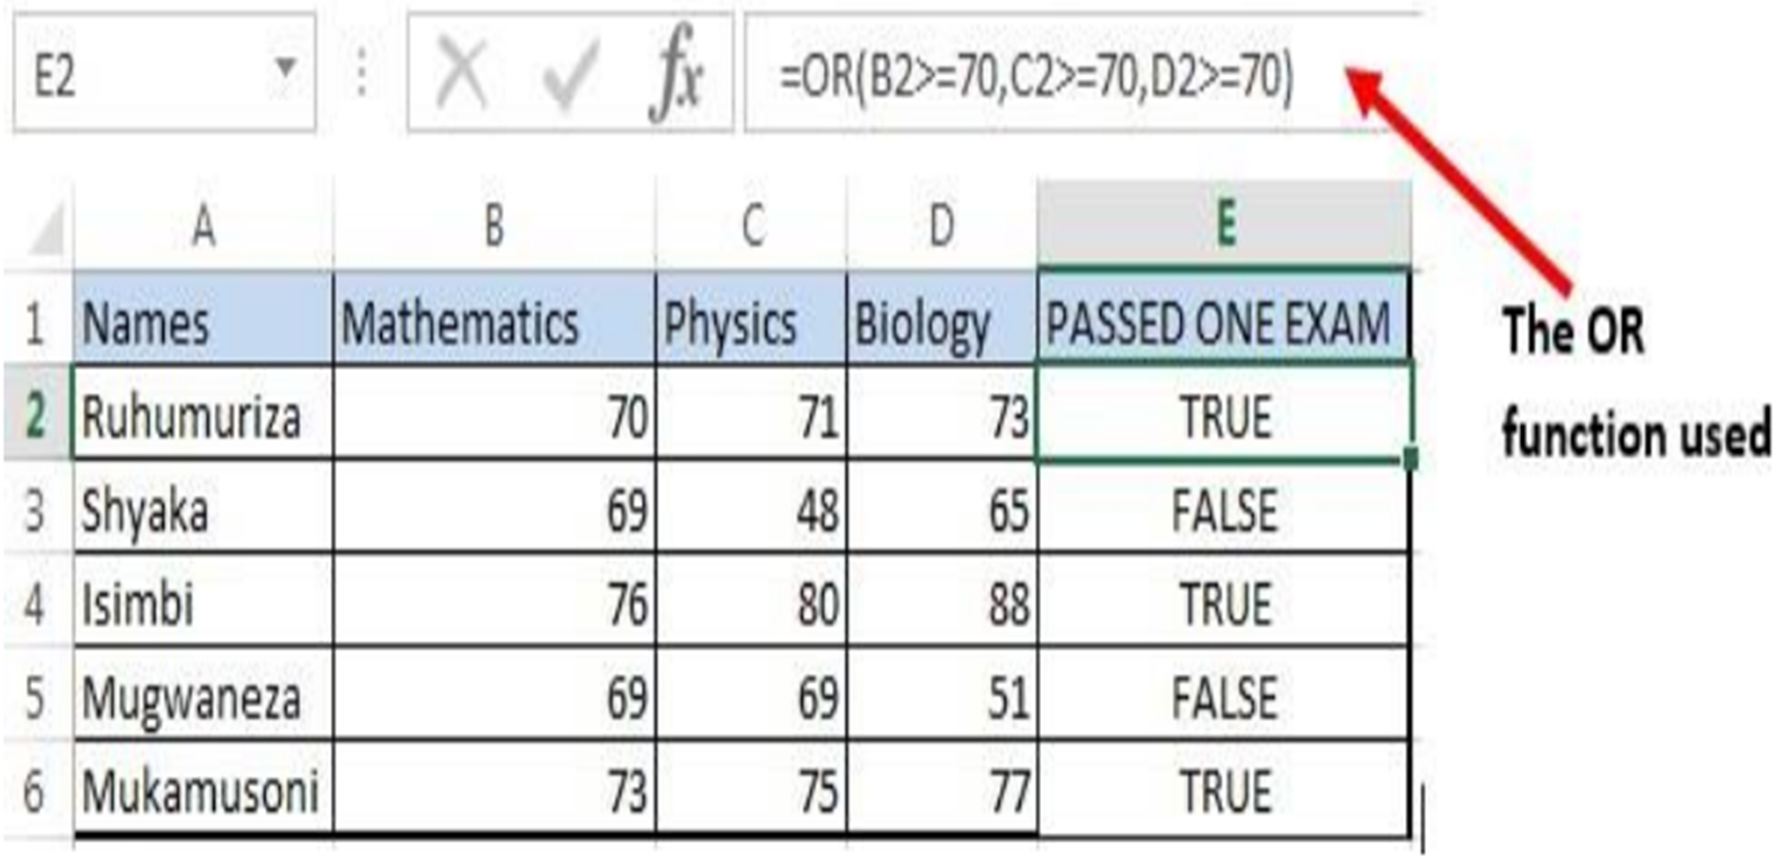
E. The OR function
The OR function is a logical function to test multiple conditions at the same time.
OR returns either TRUE or FALSE.
Syntax: = OR(logical1, Logical2, …)
Example: The OR function in the screenshot below checks for students who got more than 70% as the Pass mark in anyone of the three tests.

Slide 8
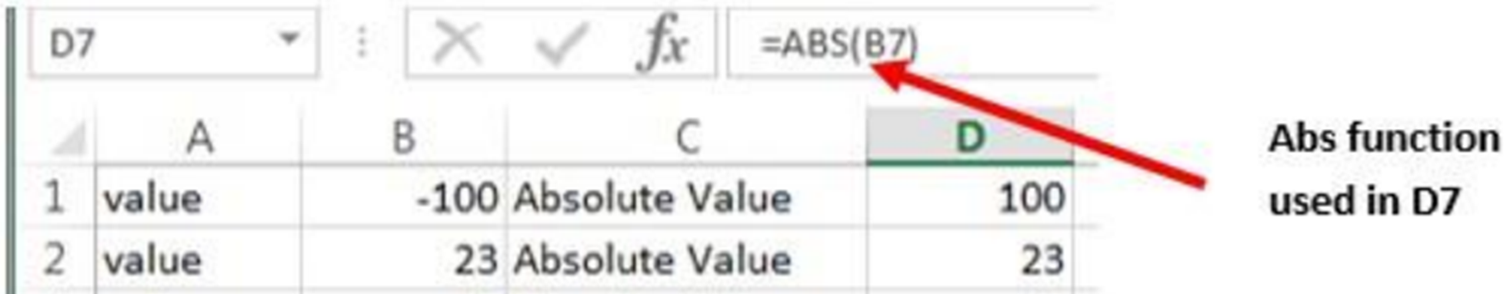
1.1.2. Advanced Math Spreadsheet functions
Some of the functions to be seen here are Abs( ), Arabic( ), Roman( ), Base( ), Mod( ) and Sqrt( ).
a. ABS
The Excel ABS function returns the absolute value of any provided number.
The syntax is: =ABS (number) nsau2020.wixsite.com/milandanet

Slide 9
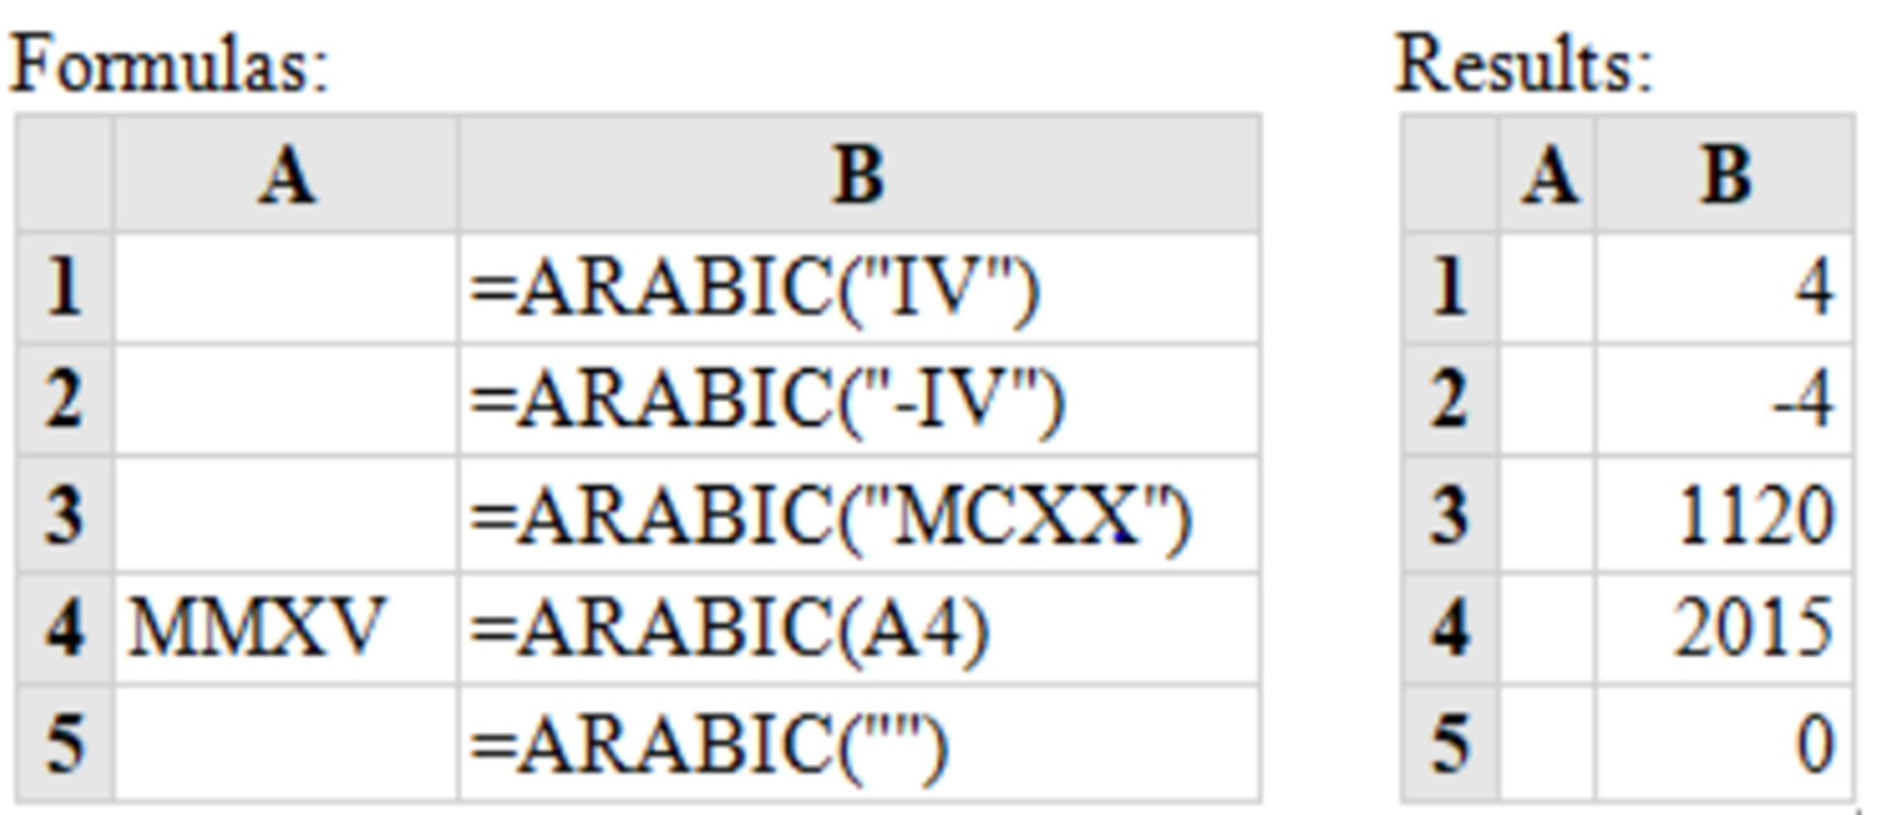
b. ARABIC
The Excel Arabic function converts a Roman numeral into an Arabic numeral.
The syntax: =ARABIC (text)
Note that:
If supplied directly to the function, the text argument must be encased in quotation marks;
If an empty text string is supplied, the Arabic function returns the value 0;

Slide 10
c. ROMAN
The Excel ROMAN function converts an Arabic number to a Roman number.
The syntax: =ROMAN (Number)
Where Number is any Arabic number.
d. BASE
The Excel Base function converts a number into a supplied base and returns a text representation of the calculated value.
The syntax: =BASE (number, base number)
e. MOD
The Excel MOD function returns the remainder of a division between two supplied numbers.
The syntax: =MOD (number, divisor)

Slide 11
f. SQRT
The Excel SQRT Function calculates the positive square root of a supplied number.
The syntax of the function is: SQRT (number)
If the supplied number is negative, the Sqrt function returns the #NUM! Error.
1.1.3. Advanced Statistical Spreadsheet functions
a. AVERAGE
The AVERAGE function in Excel returns the arithmetic mean of a list of supplied numbers, where the number arguments are a set of one or more numeric values.
Syntax of AVERAGE Function = Average (Number1, Number2, …)

Slide 12
b. AVERAGEIF
AVERAGEIF Function in Excel finds and returns the average of array that meets the specific condition.
The AVERAGEIF function in Excel supports logical operators (>, <>, =)
Syntax of AVERAGEIF Function in Excel:
=AVERAGEIF (range, criteria, [average_range])
Where:
Range: An Array of range to be tested against the supplied criteria.
Criteria: The criteria or condition on which average has to be calculated.
[average_range]: An optional array of numeric values for which the average is to be calculated.
Example of AVERAGEIF Function in Excel In the Excel screenshot below the averages of cells meeting certain conditions have been calculated.

Slide 13
Those conditions are cells with scores greater than 70, average for Irasubiza and average for science courses.
c. LARGE
The LARGE Function in Excel returns the largest value from an array of numeric values.
The syntax of LARGE Function is =LARGE (array, k) Where:
Array – An array of numeric values from which to find the K ^{th} largest value.
K- The index.
Value of K that is passed to find the K ^{th} largest value.

Slide 14
d. MEDIAN
MEDIAN function in Excel returns the statistical median or middle value of a list of supplied numbers.
Syntax of MEDIAN Function in Excel is:
= MEDIAN (number1, [number2], …)
Where the number arguments are a set of one or more numeric values for which to calculate the median.
e. MODE Function
MODE function in Excel returns the mode which is the most frequently occurring number in a group of supplied arguments.
The Syntax of MODE Function in Excel is
=MODE (number1, [number2],…)
Where the number of arguments are a set of one or more numeric values for which you want to calculate the mode.

Slide 15
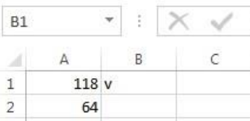
1.1.4. Text spreadsheet functions
a. CHAR
The CHAR function returns the character based on the ASCII value.
The CHAR function is a built-in function in Excel that is categorized as a String/Text Function.
The syntax for the CHAR function is:
=CHAR( ascii_value )
The ASCII value is used to retrieve the character
the following use of the CHAR function would return:
=CHAR(A1) : Gives Result: “v”
=CHAR(A2) : Gives Result: “@”
=CHAR(72) : Gives Result: “H”
=CHAR(109) : Gives Result: “m”

Slide 16
b. CONCATENATE
The CONCATENATE function in Excel is designed to join different pieces of text together or combine values from several cells into one cell.
The syntax of Excel CONCATENATE is as follows:
=CONCATENATE (text1, [text2], …)
Where text is a text string, cell reference or formula-driven value.
Below is an example of using the CONCATENATE function in Excel in which data from two cells has been combined.
The simplest CONCATENATE formula to combine the values of cells A1 and B1 is as follows: =CONCATENATE(A1, B1)
c. UPPER
The UPPER function is a built-in function in Excel that is categorized as a Text Function.
It converts a text into uppercase
Example: A1==“ better technology for the best future”
=UPPER(A1) Result: “BETTER TECHNOLOGY FOR THE BEST FUTURE”

Slide 17
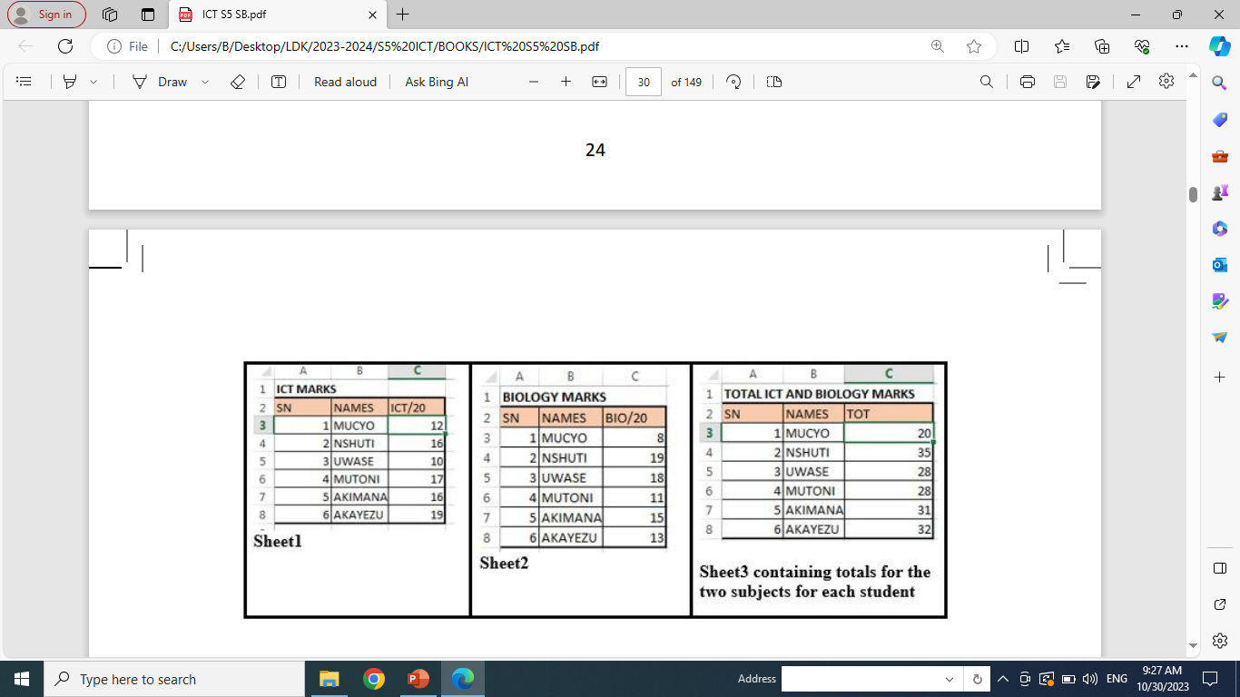
d. LOWER
The LOWER function is used to convert text into small cap text Example:
B1=“EXCEL SCIENCES THROUGH TECHNOLOGY”
=LOWER (B1) Result: excel sciences through technology
1.2. Using formula & functions from different sheets
When the workbook has many sheets there is a possibility to get data from one sheet into another by using formula or functions.
Example 1:
Consider the example where one sheet use data from two different sheets named Sheet1 and Sheet2.
These sheets contain marks for ICT and for Biology.
The teacher wants to make totals for each student for the two subjects and keep those totals in a separate sheet Sheet3

Slide 18
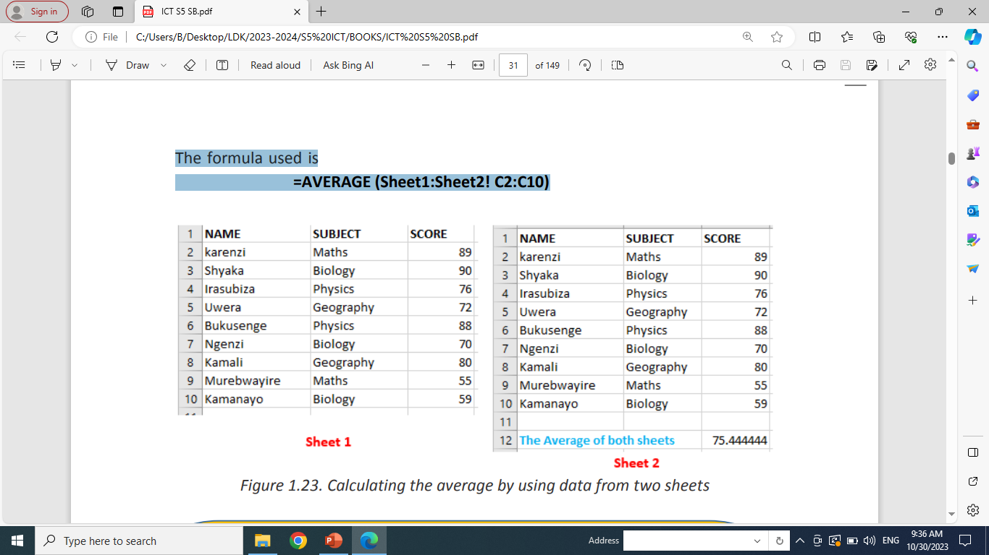
The syntax for retrieving data in one sheet to another sheet will be:
=sheet-name!cell-reference
To achieve this, go to the table in Sheet3 where totals of data from the two sheets must be done then in the TOT column cell C3 write the formula to use which is =Sheet1!C3+Sheet2!C3
Example 2:
Consider another example in which two sheets Sheet1 and Sheet2 contains data (score) on different subjects.
The average of marks contained in the two sheets is going to be calculated and kept in Sheet1.
The formula used is =AVERAGE (Sheet1:Sheet2! C2:C10)

Slide 19
1.3.1. Protecting & unprotecting worksheet
Worksheet protection is to prevent other users from accidentally or deliberately changing, moving, or deleting data in a worksheet, you can lock the cells on your Excel worksheet and then protect the sheet with a password.
With worksheet protection, you can make only certain parts of the sheet editable, and users will not be able to modify data in any other region in the sheet.
Steps to protect a sheet in Excel.
1. Under the Review tab click on Protect Sheet.
2. Type the password and click on Ok
3. Reenter password and click on Ok

Slide 20
1.3.2. Lock &unlock cells, style, contents and other elements
a. How to Lock Cells for Editing and Protect Formulas
When a sheet is shared while some sheet cells must not be modified some rules have to be set so that data can be modified by anyone who wants it but not modified by someone who does not have the right to do so.
Steps to unprotect Excel sheet with password➔ practical
1.4. Data validation
Excel Data Validation is a feature that restricts (validates) user input to a worksheet.
Technically, you create a validation rule that controls what kind of data can be entered into a certain cell.
Steps for data validation in Excel➔ practical

Slide 21
21.5. Using other Excel templates
Microsoft Excel templates are a powerful part of Excel experience and a great way to save time.
Templates are especially valuable for frequently used document types such as Excel calendars, budget planners, invoices, inventories and dashboards.
a. Creating a workbook from an existing Excel template ➔practical
b. Finding more templates ➔ practical
c. Making a custom Excel template ➔ practical

Slide 22
UNIT 2: ADVANCED POWER POINT
2.1. Create and Manage Presentations
A presentation is an organized report or message prepared as a talk before an audience, with the help of a computer program.
A presentation software is a program used to create slide shows for presentation on screen to an audience.
Example of programs/software which can be used to create presentations are the following:
Harvard Graphics,
Corel Presentations,
Lotus Freelance Graphics
Microsoft PowerPoint

Slide 23
A PowerPoint presentation is made by slides, and it can be done on computer screen if the audience is very small
If the audience is large the computer can be connected to a projector that projects the image onto a large screen or a wall.
2.1.1 Starting PowerPoint Presentation ➔ practices
2.1.2 Creating and inserting a slide in a presentation ➔ practices
2.1.3 Copying a slide ➔ practices
2. 2. Managing Slides
The following operation are performed for managing slide:
a. Hiding a slide ➔ practices
b. Moving a slides ➔ practices
c. Rearranging slides ➔ practices
d. Deleting slides ➔ practices
e. Dividing slides into sections ➔ practices

Slide 24
2.3. Apply Design Themes and Format Background
a. Design theme
Themes are predefined colors, fonts and visuals that can be applied to slides to make them have a beautiful look without doing a lot of formatting work.
Steps for Appling a theme to a slide ➔ practical
b. Format background
A background is an object which can be just a color, an image behind whatever text, charts, images in a PowerPoint presentation.
Steps for Appling a background to a slide ➔ practical
2.4. Adding Notes and Comments, Inserting Header and Footer
A. Adding comment
In PowerPoint presentation, a comment is an explanation that is attached to a text or an object on a slide, or to an entire slide.
Steps➔ practical

Slide 25
b. Adding notes ➔ practical
c. Insert header and footer ➔ practical
2.5. Add Sound and Animation to Slides
2.5.1. Animate text and picture in slides
a. Inserting pictures ➔ practical
b. Animating a text or a picture. ➔ practical
B.1. Setting the delay of animation ➔ practical
c. Customize animation effects ➔ practical
2.6 Add audio and Video Content to Slides
a. Inserting an audio ➔ practical
b. Inserting a video recorded ➔ practical
c. Inserting a screen capture➔ practical
Notes:
a. Presenting using a projector A projector is an output device that can take images generated by a computer and produce them by projection onto a screen, wall or another surface. A projector is connected to the computer through the VGA port but new projectors and computers can be connected using the HDMI ports

Slide 26
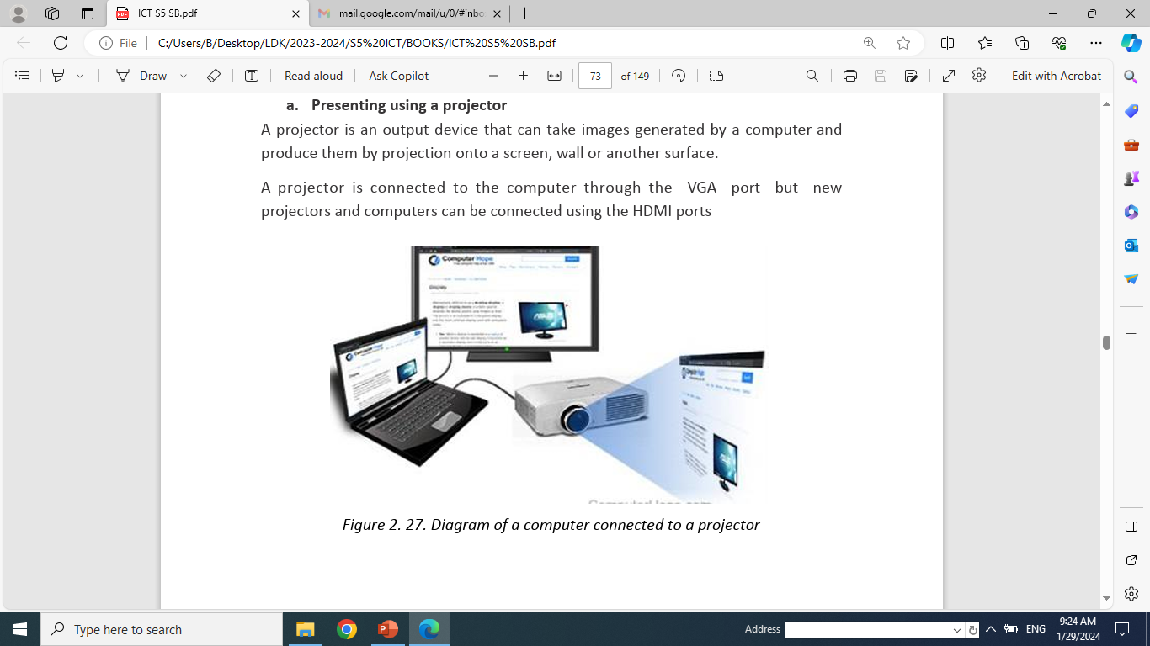
2.7. Slide Transitions
A slide transition is the visual effect that occurs when moving from one Slide to the next during a presentation.
a. Types of transitions
In PowerPoint 2019 there are three main slide transitions namely subtle, exciting and dynamic content.
b. Steps using a transition ➔ Practical
2.8 Presenting Using PowerPoint
a. Presenting using a projector
A projector is an output device that can take images generated by a computer and produce them by projection onto a screen, wall or another surface.
A projector is connected to the computer through the VGA port, but new projectors and computers can be connected using the HDMI ports

Slide 27
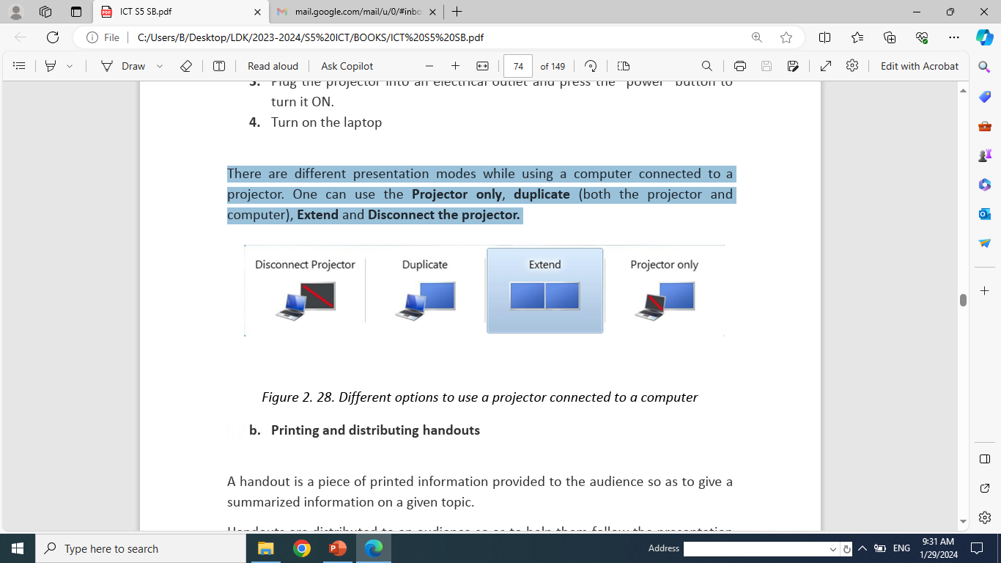
Steps for connecting a laptop to a projector ➔ demonstration
There are different presentation modes while using a computer connected to a projector.
One can use the Projector only, duplicate (both the projector and computer), Extend and Disconnect the projector.

Slide 28
For a presentation to be effective, the PowerPoint document have to have these qualities:
  Make the PowerPoint presentation short. Slides will contain short and concise sentences which are bulleted,
  Highlight important points by using animations and transitions wisely not randomly as these are used with a purpose like attracting attention on certain section, notifying of the change in the topic, etc.
  For long slides provide short partial synthesis to make the audience keep track of what is so far presented
  Rehearse the presentation and use scripts and notes to help you not forget the important points to mention
  Be polite and use appropriate language.

Slide 29
UNIT 3: COMPUTER GRAPHICS TOOLS
3.1. Introduction to Computer Graphics
Modifying a hard drawing can be hard, swapping colors or resizing a picture on such a drawing is more complicated.
Computer Graphics involves the ways in which images can be displayed, manipulated and stored using a computer.
Computer graphics provides the software and hardware techniques or methods for generating images.
3.1.1. Definitions of Different Terms
Computer graphic: This is the use of a computer and specialized programs to produce and manipulate pictorial images.

Slide 30
Pixel: is the smallest unit of a digital image or graphic that can be displayed and represented on a digital displayed device.
A pixel can have different colors produced by mixing the three colors RGB (Red, Green and Blue) and each of the three colors can take values ranging from 0 to 256.
2D (2Dimensional) images are objects that are rendered visually on paper, film or on screen in two planes representing width and height (X and Y).
3D computer graphics or three-dimensional computer graphics are graphics that use a three-dimensional representation of geometric data (often Cartesian) that is stored in the computer for the purposes of performing calculations and rendering 2D image.

Slide 31
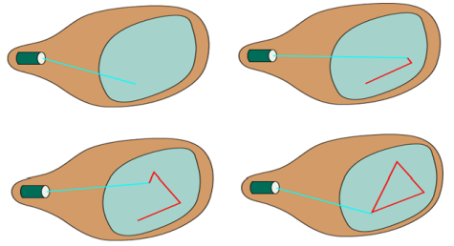
Morphing: is a technique which involves using a computer to make an image on film or television appear to change shape or change into something else.
Random scan: Random Scan System uses an electron beam which operates like a pencil to create a line image on the CRT (Cathode Ray Tube) screen.
The picture is constructed out of a sequence of straight-line segments.
Each line segment is drawn on the screen by directing the beam to move from one point on the screen to the next, where its x & y coordinates define each point.
After drawing the picture, The system cycles back to the first line and design all the lines of the image 30 to 60 time each second.

Slide 32
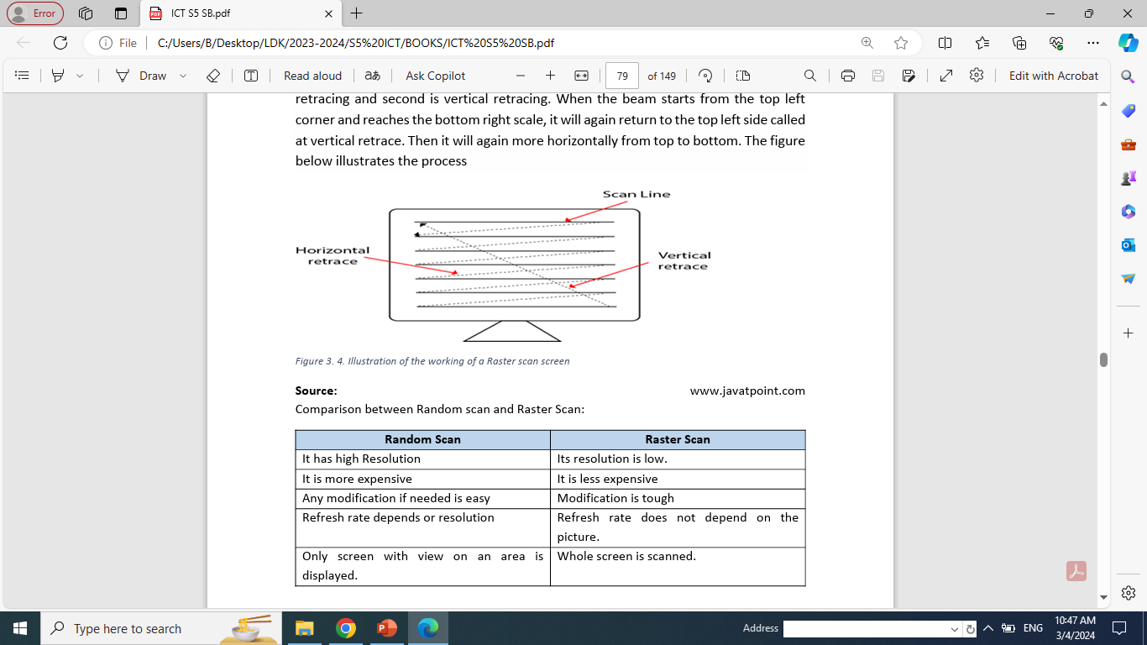
A raster scan display is based on intensity control of pixels in the form of a rectangular box called Raster on the screen.
Raster Scan provides a refresh rate of 60 to 80 frames per second.

Slide 33
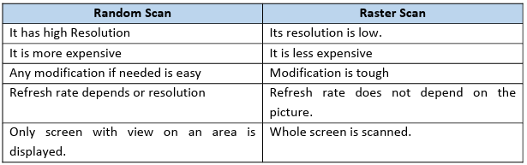
Source: Comparison between Random scan and Raster Scan:
3.2. Image Format
3.2.1. Definition
Image file formats are standardized means of organizing and storing digital images.

Slide 34
Image files are composed of digital data in one of the formats that can be rasterized for use on a computer display or printer.
TIFF stands for Tagged Image File Format.
TIFF images are uncompressed and thus contain a lot of detailed image data (which is why the files are so big)
JPEG stands for Joint Photographic Experts Group, which created this standard for this type of image formatting.
JPEG files are images that have been compressed to store a lot of information in a small-size file.
Most digital cameras store photos in JPEG format, because then you can take more photos on one camera card than you can with other formats.

Slide 35
GIF stands for Graphic Interchange Format.
This format compresses images but, as different from JPEG.
PNG stands for Portable Network Graphics.
3.2.2 Image compression
Image compression is minimizing the size in bytes of a graphic file without degrading the quality of the image to an unacceptable level.
Image compression techniques Lossy and Lossless
Lossless: The compression technique where compressed data (byte) will be the same replica of actual data.
Lossy: File compression results in lost data and quality from the original version.

Slide 36
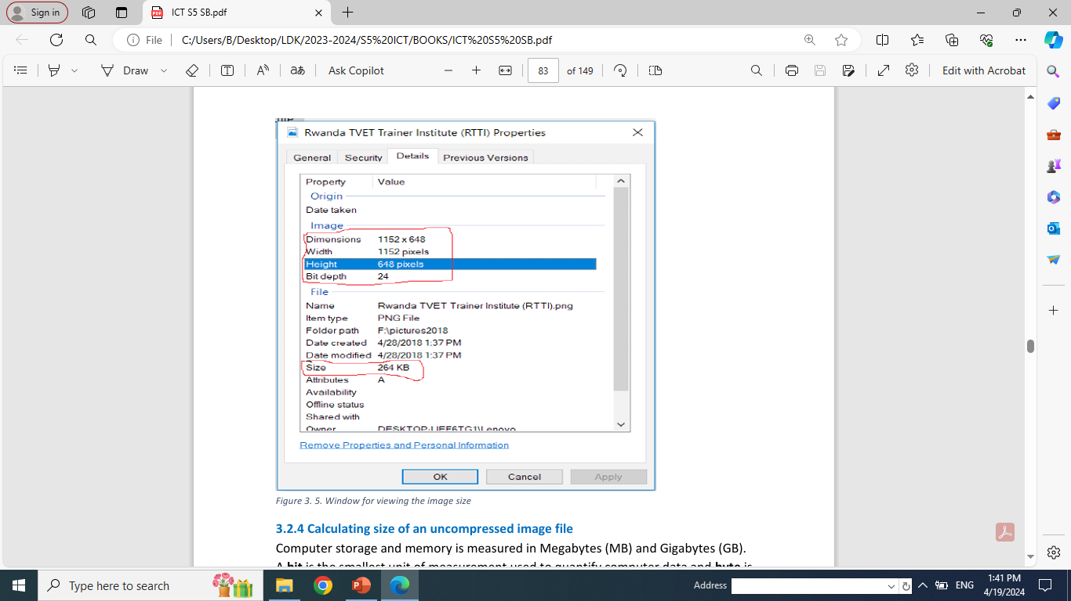
3.2.3 Viewing an image’s file size and dimensions
The determination of an image’s file size and dimensions depends on an Operating System being used.
Right clicking the icon of the image file,
In the popup menu, click on property and details.
The result will look like below.

Slide 37
3.2.4 Calculating size of an uncompressed image file
Computer storage and memory is measured in Megabytes (MB) and Gigabytes (GB).
A bit is the smallest unit of measurement used to quantify computer data and byte is a group of 8 binary digits.
Unit of memory size.
1Byte= 8bits
1KB= 1024Bytes
1MB = 1024 KB
1GB=1024 MB
1TB=1024 GB
1PB=1024TB

Slide 38
Example: Let‘s consider an image whose Width is 1152 and height is 648.
If we consider 3 bytes of storage, the file size of a color image is width * height * 3.
which is =1152*648*3 = 2,239,458 which gives the file size in bytes.
3.3 Image Capturing Tools
3.3.1. Digital Camera
The first digital camera was invented by STEVEN SASSON in 1975.
Digital cameras are normally used to capture pictures or video using an electronic image sensor.
There are two types:
SLR: Single Lens reflex camera; which is a camera that typically uses a mirror and a prism system that permits the photographer to view through the lens and see exactly what will be captured.
DSLR: is a digital camera that combines the optics and the mechanisms of a single lens reflex camera with a digital imaging sensor.

Slide 39
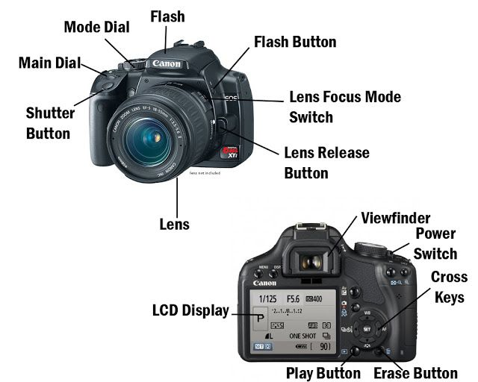
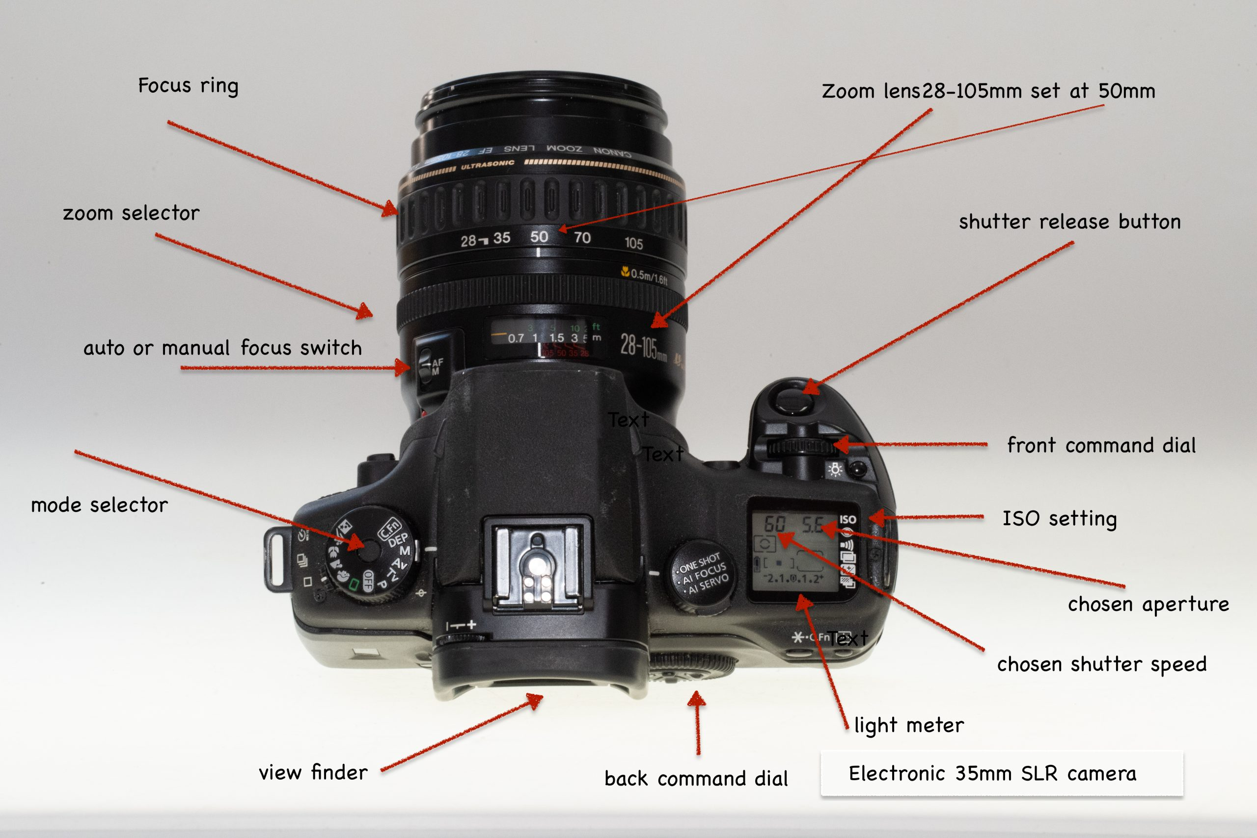
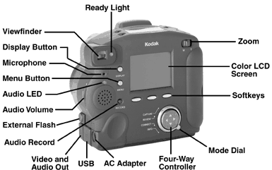
Digital camera parts
Lens
Viewfinder
Body
Shutter Release
Aperture
Image Sensor
Memory Card
LCD Screen
Flash
User Controls

Slide 40
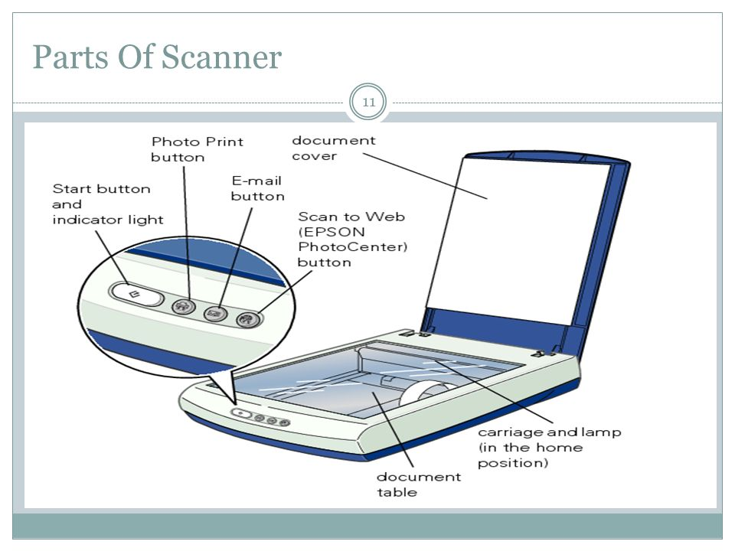
3.3.2 Scanner
A scanner is an electronic device which can capture images from physical items and convert them into digital formats, which in turn can be stored in a computer and viewed or modified using software applications.
A scanner has the following five parts visible externally:
Start button
Copy button
Scan to E-mail button
Scan to Web button
Scanner cover

Slide 41
3.4 Screenshots Capturing
The main ways used to get the screen of computer is to use the Print Screen key (PrtSc) or the Snipping Tool
3.5. Graphic Software-Paint
In computer graphics, graphics software refers to a program or a collection of programs that enable a person to manipulate images on a computer.
Examples of such programs include Adobe Photoshop, Microsoft Publisher, Paint, Etc.
Practical➔ use of paint software

Slide 42
UNIT 4: E COMMERCE, SOCIAL MEDIA AND ONLINE SERVICES
4.1. E- commerce
Definition➔
4.1.1. Understanding E –Commerce
a. History ➔
b. Some Ecommerce platforms ➔
c. Buying on an e-commerce platform ➔
a. Advantages of E-commerce ➔
b. Disadvantages of E-commerce ➔
4.1.2. E-commerce models ➔
4.2. Online Payment Methods
Definition➔

Slide 43
Types of payment methods used in a modern business context ➔
Explain them: ➔
Social medias
List any 10 social media you know➔
Peek four social medias of your choice and explain all requirements that you must fulfill in order to be monetized on them ➔
4.7. E-Banking and E-Payment
a. E Banking ➔
b. E payment ➔
4.8. Irembo Local Online Services
Meaning of Irembo Local online services➔
How to create account from irembo ➔
a. Requesting for Irembo service ➔
b. Current Irembo services ➔

Slide 44
Unit 5 Database basics
5.1. Definitions of key terms
i. Data
Data is commonly referred to as raw data – a collection of text, numbers and symbols, images with no meaning.
Data therefore must be processed, or provided with a context, before it can have meaning.
ii. Information
Information is the result of processing data, usually by computer.
This results in facts, which enables the processed data to be used in context and have meaning.
iii. Database
Database is an organized collection of related data.
It is organized because the data is stored in categories that are accessible in a logical manner.

Slide 45
A database is a collection of one or more relations, where each relation is a table made of rows and columns.
5.2. Different area where database can be applied
Databases touch all aspects of our lives such as:
Human resources, Banking, Airlines, Universities, Telecommunication, Finance, Manufacturing.
5.3. Database approaches
5.3.1 Traditional File Processing Systems (TFPS) approach
This is an approach which was used earlier, prior to DBMS.
With this approach, users had to write their application programs to store data in form of files on the computer permanent storage device (Hard Disk).

Slide 46
5.3.2 Database Management System (DBMS)
Database Management system (DBMS) is referred to as a software system that is used to store, access, manage, organize, maintain, modify and delete data from databases.
Some of the most popular software include, Microsoft Access, Oracle, Microsoft SQL Server, MySQL.
5.4 Database access levels and users
5.4.1. Database access levels
A major purpose of a database system is to provide users with an abstract view of the data.
There are three-levels that form the basis of modern database architectures:

Slide 47
The internal level has an internal schema, which describes the physical storage structure of the database.
The conceptual level has a conceptual schema, which describes the structure of the whole database for a community of users.
The external or view level is closest to the users. It is concerned with the way the data is viewed by individual users.
5.4.2 Database users
There are three broad classes of user:
a. Database administrator (DBA): Responsible for authorizing access to the database, for coordinating and monitoring its use.
b. The database designer: Responsible to define the content, the structure, the constraints, and functions of database.

Slide 48
c. The end-user: They use the data for queries, reports
5.5 Relational Model
5.5.1 Definition of Relational Database Model
The Relational Database Model represents the database as a collection of relations. A relation is nothing but a table of values.
5.5.2 Relational Model Concepts in DBMS
Entity is a real-world object that has certain properties called attributes that define the nature of the entity. It is also called a Table.
Primary Key is also called a primary keyword, is a key (column) in a relational database that is unique for each record.
Foreign Key is a set of attributes (columns) in a table that refers to the primary key of another table.

Slide 49
Attribute: it is the name of each column in a Table.
Constraint: In DBMS is the set of rules that ensures that when an authorized user modifies the database.
Tuple: It is nothing but a single row of a table, which contains a single record.
Degree: is the total number of attributes.
Cardinality: is the total number of rows present in the table.

Slide 50
END OF ICT IN SENIOR FIVE

