Slide 1

ICT FOR S6
Facilitator: Augustin NSENGIYUMVA

Slide 2
SENIOR SIX ICT CONTENT
UNIT 1. DATABASE DESIGN
UNIT 2: SQL AND DATABASE PROJECT
UNIT 3: INTRODUCTION TO VISUAL BASIC
UNIT 4: INTRODUCTION TO WEB DESIGNING

Slide 3
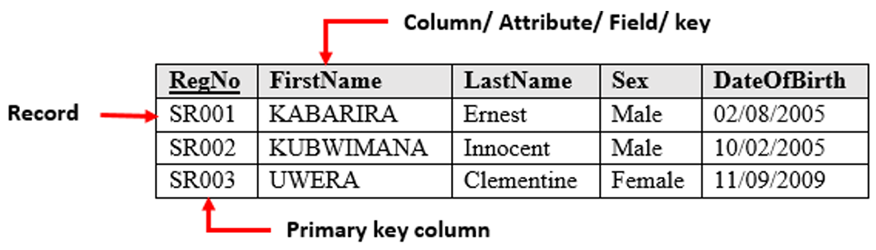
UNIT 1. DATABASE DESIGN
1.1. Database models
A data model shows the logical structure of a database including the relationships and constraints that determine how data can be accessed and stored.
1.1.1. Relational model
The most common model, the relational model sorts data into tables known as relations.
A relation (table) consists of columns (attribute).
All attributes in a table are called Domain.
One attribute or a group of attribute are chosen to be a primary key or a foreign key.

Slide 4
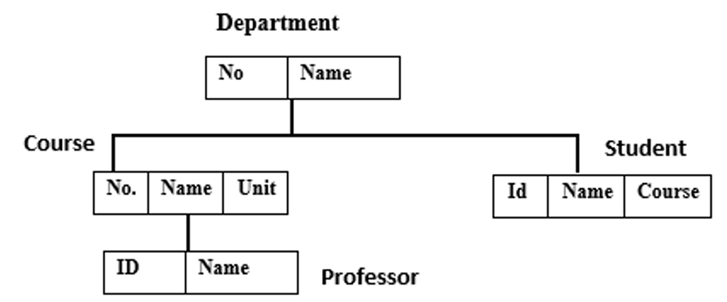
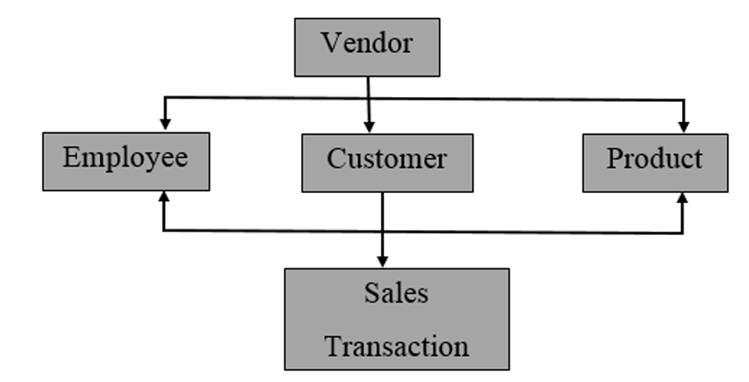
1.1.2. Hierarchical model
The hierarchical model organizes its data using a tree structure.
1.1.3. Network model
The network model builds on the hierarchical model by allowing many-to-many relationships between linked records, implying multiple parent records.

Slide 5
1.1.4. Object-oriented database model
An object-oriented database is a database system in which information is represented in the form of real-life objects as used in object-oriented programming.
A. NoSQL database models
NoSQL databases also known as not only SQL are non-tabular databases and store data in a different way compared to relational tables.
There are different types of NoSQL databases basing on their data model namely document, key-value, wide-column, and graph.

Slide 6
1.2. Database relational model
A Relational Model represents the database as a collection of relations (tables).
Each relation consists of a collection of rows and columns filled with data.
The table name and column names are helpful to interpret the meaning of values in each row.
To implement a relational database model there are different Relational Database Management Systems such as Oracle, DB2, SQL Server, MySQL, Access.
There are different concepts which are specific of the relational model as explained below:
Attribute: Each column in a table is referred to as Attribute.

Slide 7
Tables is where data are stored in a format having rows and columns.
Tuple: It is a single row of a table, is a single record.
Relation Schema represents the name of the relation with its attributes.
Degree is the total number of attributes.
Cardinality: This is the total number of rows present in a table.
Column the set of values for a specific attribute.
Relation instance is a finite set of tuples in the RDBMS.
Attribute domain is the predefined value and scope that an attribute can take.
1.2.1. Relational Integrity Constraints
In a Relational database management system, constraints can be divided into three main categories namely the Domain Constraints, Key Constraints and Referential Integrity Constraints.

Slide 8
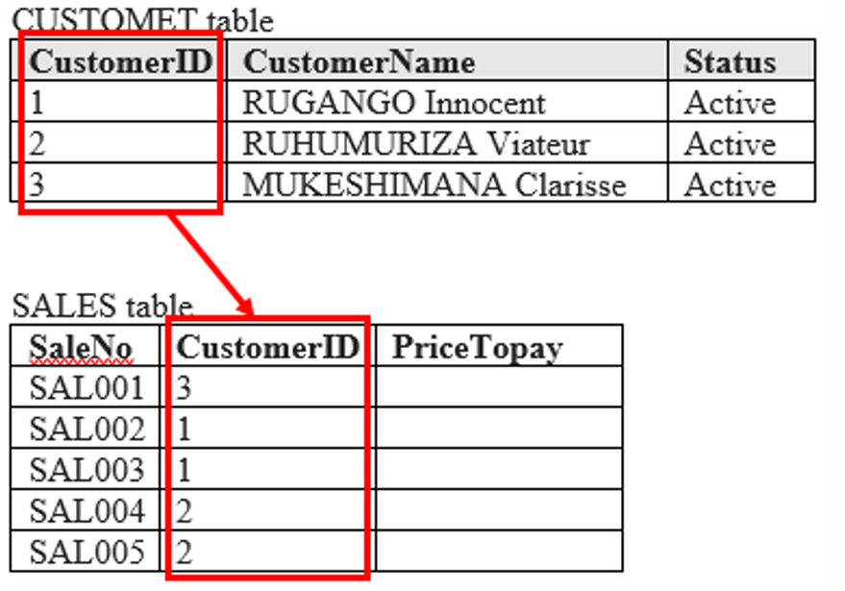
A. Domain Constraints
Domain constraints means that a certain table accepts only allowed set of values.
If the data that the database user is attempting to enter in the database are not included in those allowed the data being entered is rejected.
B. Key Constraints
An attribute that can uniquely identify a tuple in a relation is called the key of the table.
C. Referential integrity constraints
This constraint is based on the Foreign Key concept.
A foreign key is an attribute of a relation which refers to in other relation.

Slide 9
D. Operations in relational database
Database operations includes: Insert, update, delete and select.
1.2.2. entity relationship diagram( ERD)
An ERD is a graphical representation that depicts relationships among relation of particular database.
They help to visualize how data is connected in a general way, and are particularly useful for constructing a relational database.
1.3. Database design steps
1. Investigate the information.
2. Identify the objects.
3. Model the objects.

Slide 10
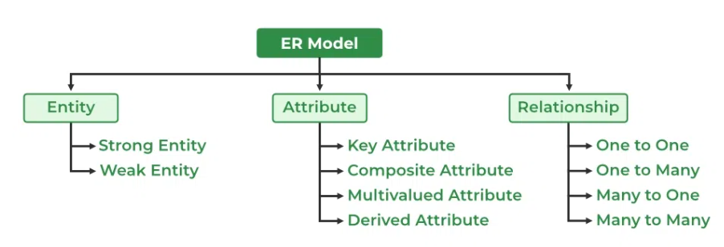
4. Identify the types of information for each object.
5. Identify the relationships between objects.
6. Database optimization through normalization.
7. Data entry and manipulation
1.4. ER Model in Database Design Process
Group discussion(10 Marks)
With the help of clear example explain the step for developing database

Slide 11
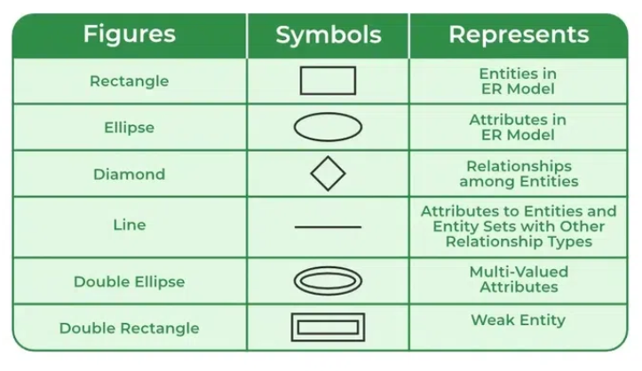
1.4.1 Symbols Used in ER Model
ER Model is used to model the logical view of the system from a data perspective which consists of these symbols:
Rectangles: Rectangles represent entities in the ER Model.
Ellipses: Ellipses represent attributes in the ER Model.
Diamond: Diamonds represent relationships among Entities.
Lines: Lines represent attributes to entities and entity sets with other relationship types.
Double Ellipse: Double ellipses represent multi-valued Attributes, such as a student's multiple phone numbers
Double Rectangle: Represents weak entities, which depend on other entities for identification.

Slide 12
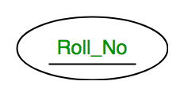
A. Types of Entity
There are two main types of entities:
1. Strong Entity
A Strong Entity is a type of entity that has a key Attribute that can uniquely identify each instance of the entity.
2. Weak Entity
A Weak Entity cannot be uniquely identified by its own attributes alone.
B. Attributes in ER Model
Types of Attributes
1. Key Attribute

Slide 13
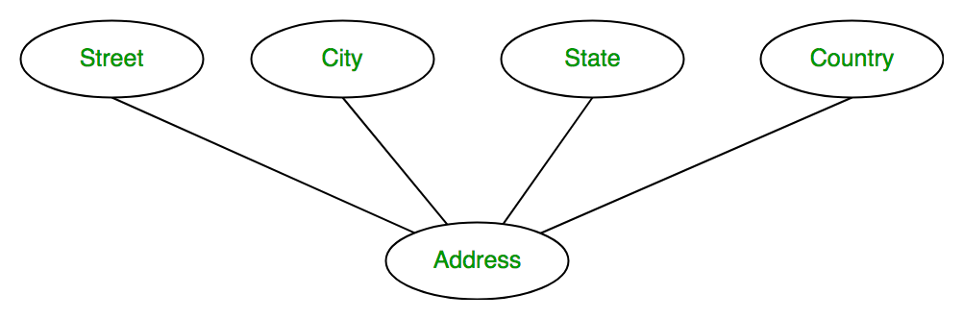
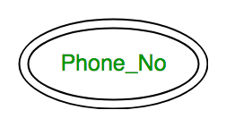
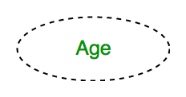
2. Composite Attribute
3. Multivalued Attribute
4. Derived Attribute

Slide 14
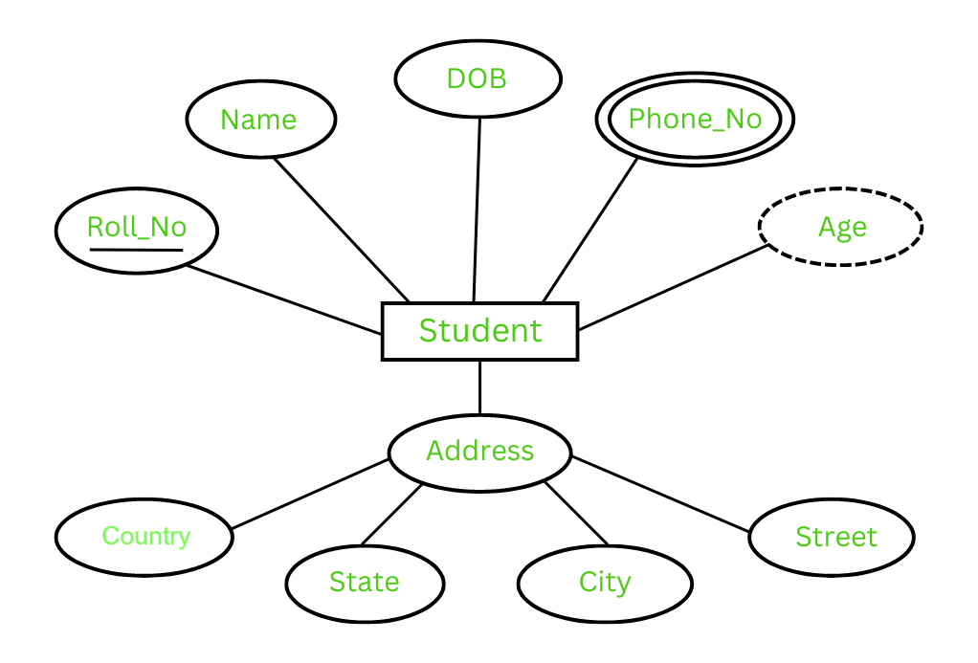
The Complete Entity Type Student with its Attributes can be represented as:

Slide 15
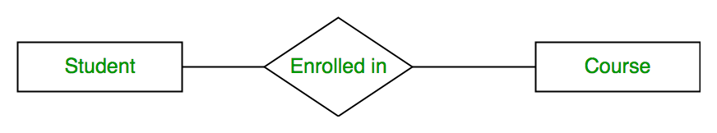
C. Relationship Type and Relationship Set
A Relationship Type represents the association between entity types.
For example: Enrolled in is a relationship type that exists between entity type Student and Course.
In ER diagram, the relationship type is represented by a diamond and connecting the entities with lines.
Degree of a Relationship Set
The number of different entity sets participating in a relationship set is called the degree of a relationship set.

Slide 16
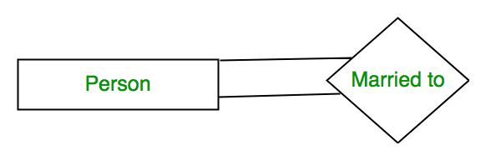

1. Unary Relationship:
2. Binary Relationship:
3. Ternary Relationship:
When there are three entity sets participating in a relationship, the relationship is called a ternary relationship.
4. N-ary Relationship:
When there are N entities set participating in a relationship, the relationship is called an n-ary relationship.

Slide 17
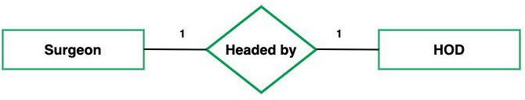
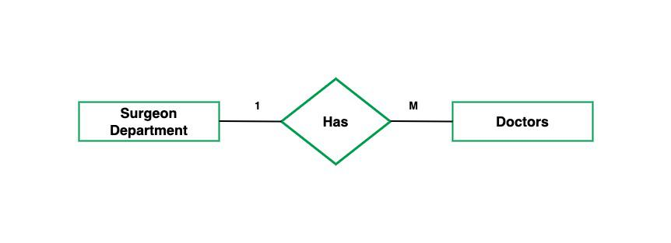
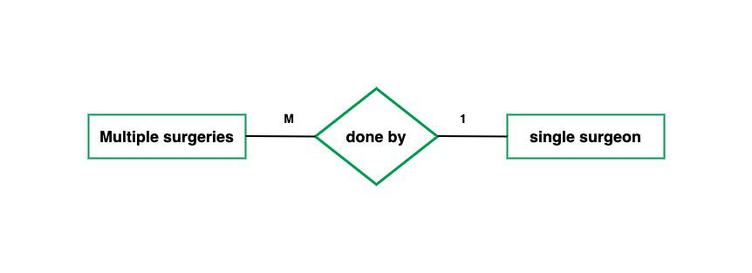
Cardinality in ER Model
The maximum number of times an entity of an entity set participates in a relationship set is known as cardinality.
Cardinality can be of different types:
1. One-to-One
2. One-to-Many
3. Many-to-One

Slide 18
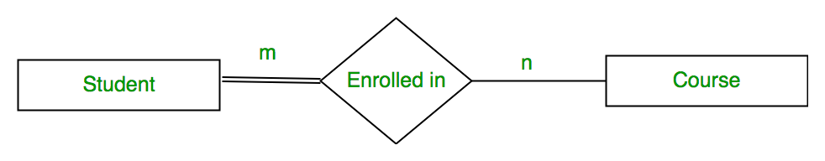
Participation Constraint
Participation Constraint is applied to the entity participating in the relationship set.
1. Total Participation
Each entity in the entity set must participate in the relationship.
Total participation is shown by a double line in the ER diagram.
2. Partial Participation
The entity in the entity set may or may NOT participate in the relationship.

Slide 19
1.5. Database Optimization through Normalization
Normalization is a database design technique that reduces data redundancy and eliminates undesirable characteristics like Insertion, Update and Deletion Anomalies.
1.5.1. Database anomalies
When database is not normalized, it presents anomalies namely insert anomaly, delete anomaly and update anomaly.
1.5.2. Types of Normal Forms
Normalization is a method to remove the anomalies so as to bring the database to a consistent state.
Normalization involves different Normal Forms the most common being used is the First Normal Form, Second Normal Form and Third Normal Form.

Slide 20
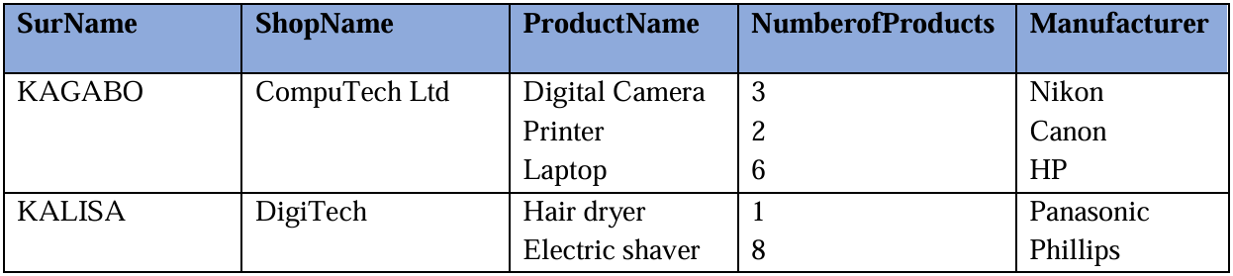
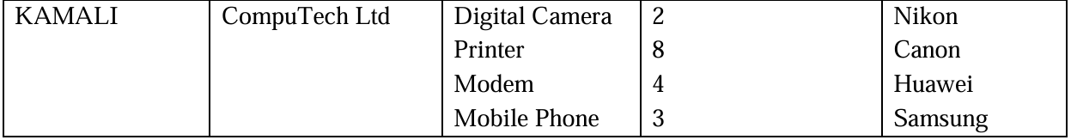
A. First Normal Form
A relation that contains a repeating groups of data or multiple entries for a single record is called unnormalized relation.
Removing repeating groups is the starting point in the process to create tables that will not cause problems when the database starts being used.
The conversion to first normal form (1NF) requires splitting the data that was in one non atomic cells and put it in more than one record.
Example:

Slide 21
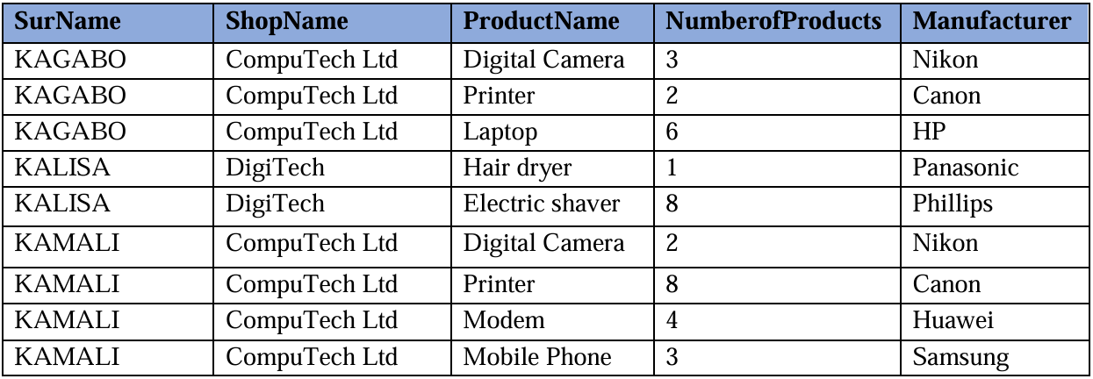
In summary the previous table has non-atomic cells where some cells contain more than one data like in the second record where in the Manufacturer column there is the content Panasonic and Phillips.
This table is converted to the First Normal Form by splitting non-atomic cells and becomes the table below:

Slide 22
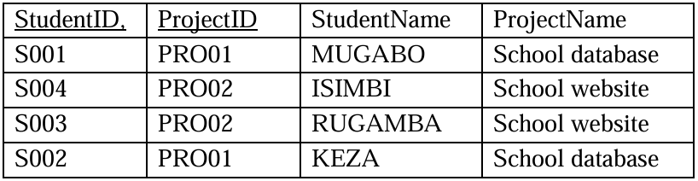
B. Second Normal Form
A table in Second Normal Form must first be in the First Normal Form.
The relation is automatically in 2NF if, and only if, the Primary Key comprises a single attribute.
If a table has a composite primary key no attribute should depend on part of the primary key.
If one attribute is dependent on part of the primary key this is referred to as Partial Dependency.
Example:
Consider the table below with a composite primary key with the primary key columns (Student_ID, ProjectID and other columns StudentName and ProjectName).

Slide 23
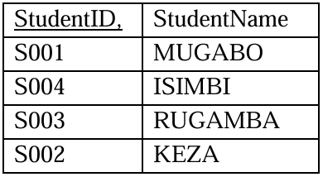
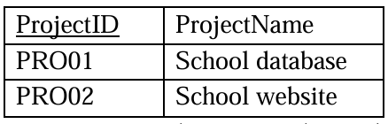
This table is in the First Normal Form but not in the Second Normal Form.
To convert it in the Second Normal Form, this partial dependency must be removed by splitting the table in such a way that columns which depend to one another make one table.
The new tables get new names respectively STUDENT and PROJECT with the structure below:
STUDENT (StudentID, StudentName) here the StudentID becomes the primary key
PROJECT (ProjectID, ProjectName) here the ProjectID becomes the primary key

Slide 24
C. Third Normal Form
To be in third normal form, the relation must be in second normal form.
Also, all transitive dependencies must be removed.
A non-key attribute may not be functionally dependent on another non-key attribute.
In our case on table PRODUCTSSOLD, Manufacturer attribute is dependent on ProductName, which is not the primary key of the PRODUCTSSOLD table therefore there is no key dependency.
Consider the SHOPSALES table with the columns SurName, ShopName, ProductName, Numberof Products and Manufacturer.
This table was split in two in order to make it be in the Second Normal Form and the resulting tables are:
SELLER(SurName, ShopName)
PRODUCTSSOLD(SurName, ProductName, NumberofProducts, Manufacturer).

Slide 25
The table PRODUCTSSOLD is not in 3NF as there is transitive dependency between ProductName and manufacturer.
The new generated tables are:
SELLERS (SurName, Shop)
PRODUCTSSOLD (SurName, ProductName, NumberofProducts)
PRODUCTS (ProductName, Manufacturer)
1.6. Data types in Access
A data type is a set of possible values and a set of allowed operations on it.
In Access, when creating tables, the data type for each column of data must be specified.
The data types in Access are:
Short text, long text, number, date/time, currency, autonumber, Yes/No, OLE Object, Hyperlink, Attachment, Calculated, and Lookup Wizard

Slide 26
1.7. Database creation
A. Steps for creating database in Microsoft Access
Step 1: Open Microsoft Access
Step 2: Click on Blank database in the task pane
Step 3: Name your database file (say Company)
Step 4: Click the Create button to create the database.
B. Creating tables inside the database using in Design View
Step 1: In the database already created, click on Create
Step 2: In the tools that appears click on the Table icon
Step 3: Under the File menu click on the View arrow
Step 4: Click on Design View tool and save the new table as prompted to do so
Step 5: In the new window that appears write the field names and set the data types for those fields

Slide 27
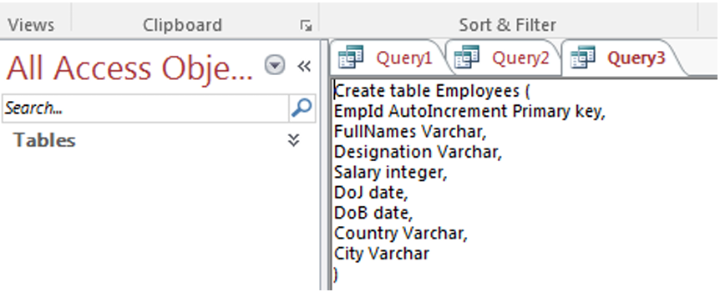
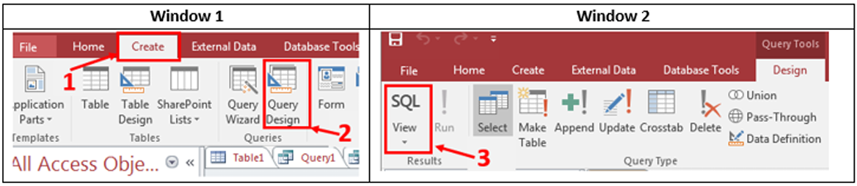
C. Creating tables inside the database using in SQL View
Step 1: Click on Create menu
Step 2: Click on Query Design tool and close the Show table window that pops up
Step 3: Click on SQL view tool. Immediately the area where the SQL query is to be written appears
Step 4: Write the query and run it to get results.
Step 5: Click on SQL view tool, Immediately the area where the SQL query is to be written appears.
A query to create the table that was created in Design view looks like this:

Slide 28
1.8. Manipulation of data in an Access table
1.8.1. Entering data in datasheet view
The entering of data in an Access table will depend on the type of data to enter.
When it is text data entry will be done by just placing the cursor in the cell and writing the text.
Thus, the new record added will go at the bottom of the table.
1.8.2. Sorting and filtering data
A. Sorting
Step 1: Select the column on which sorting is to be applied.
Sorting in Access is done by placing the cursor at the top of the column
Step 2: On the Home tab click on Ascending or Descending depending on the type of sort to be applied.
Immediately the data gets sorted by the column that was selected

Slide 29
B. Filtering
Filtering is a way of displaying only needed data.
Step 1: Select the column containing the data to be filtered
Step 2: On the Home tab click on the Filter icon
Step 3: In the new dialog box select the column on which the filter is to be applied
Step 4: Click on OK
1.8.3. Importing and Exporting
Import data from other files follow these steps:
Step 1: Under the External Data menu in the Import & Link group click on any application from where the data is to be imported from.
Step 2: In the new dialog box select the source and destination of the data by first browsing the files on your computer and then specifying how and where to store the data in the current database
Step 3: Click OK to approve the options chosen

Slide 30
Step 4: In the next dialog boxes that appear choose different options by using the different dialog boxes provided.
Among the options to choose is making the first row contain column headings, choosing the primary key, etc.
In all these options the dialog boxes will guide the process.
Exporting data from Access to other applications is done also by using the External Data menu. The steps are shown below:
Step 1: Under the External Data menu in the Export group click on one of the application
icons. In this case the icon for Excel was clicked.
Step 2: Browse the folders on the computer so as to choose where the new exported file will be
stored and its format. Here also specify different options like Export data with formatting and layout
Step 3: Click Ok. Immediately the new file will be stored to the location specified.

Slide 31
1.8.4. Creating a query in design view
A. First method:
Step 1: Under the Create menu in the Queries group click on Query Design
Step 2: In popup dialog box, choose the tables on which the query will be run
Step 3: Click Add to make those tables be part of the query
Step 4: Click Add
Step 5: Select the columns to appear in the query results by double clicking them.
Step 6 (Optional): If the query is based on more than one table, link the related columns by dragging the column name from one table to the column to the other table.
Step 7: Run the query by clicking on Run icon

Slide 32
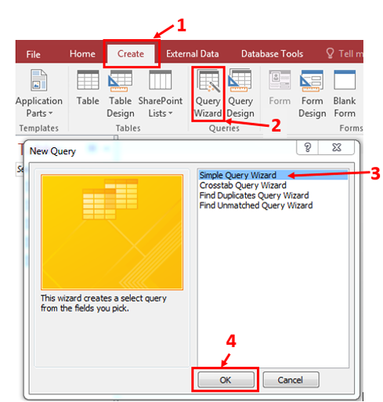
B. Second method:
Creating a query by using the query wizard
Step 1: Click on Create menu,
Step 2: In the queries group click on Query Wizard
Step 3: Select (Click) one query type that is going to be used. The query types can be Simple Query Wizard, Crosstab Query Wizard, Find Duplicate Query Wizard, Find Unmatched Query Wizard. In this example the Simple Query Wizard was selected.
Step 4: Click OK

Slide 33
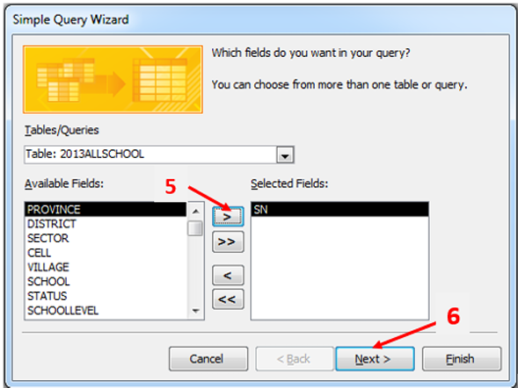
Step 5: In the new dialog box select the columns which will appear in the results of the query. The selected fields will move to the right in the area under Selected fields
Step 6: Click Next and follow the prompts. When the Next button is no longer active click on Finish.

Slide 34
UNIT 2: SQL AND DATABASE PROJECT
2.1. Introduction to Structured Query Language
Structured Query Language (SQL) is a computer language that is used to request, add, update, to remove data within a database.
Commonly used statements are grouped into three categories:
Data Definition Language(DDL): refers to the set of SQL statements that can create and set the structures of a database.
DDL is a set of SQL commands used to create, modify, and delete database structures but not data.
Data Manipulation Language (DML)refers to a data manipulation language is a set of commends used for adding, deleting, and modifying data in a database.

Slide 35
Data Control Language(DCL) includes commands such as GRANT and REVOKE which mainly deal with the rights, permissions, and other controls of the database system.
2.2. Data Definition Language (DDL)
Common DDL statements include:
CREATE (generates a new table)
ALTER (alters table)
DROP (removes a table from the database)
2.2.1 Creating and saving a database
Here is the SQL Syntax to create a new database into RDBMS:
CREATE DATABASE databasename;
Note that MS Access doesn’t allow a user to create a database using the SQL statement CREATE DATABASE
In other RDBMS software this SQL statement can be executed by the user.

Slide 36
2.2.2 CREATE TABLE STATEMENT
The syntax for creating a new table is:
CREATE TABLE tablename (column1 datatype, column2 datatype, column3 datatype, .....columnn datatype, primary key (one or more columns) );
2.2.3 DROP TABLE STATEMENT
This statement deletes the entire structure as well as the content of the table.
The syntax of drop table statement is as follows:
DROP TABLE table_name;
2.2.4 ALTER TABLE STATEMENT
The ALTER TABLE statement is used to add, delete or modify columns in an existing table
Use the SQL Command ALTER TABLE followed by either ADD or DROP or MODIFY.
ALTER TABLE command can also be used to add and drop various constraints on an existing table.

Slide 37
The basic syntax of ALTER TABLE to add a new column in an existing table is:
ALTER TABLE table_name ADD column_name datatype;
The basic syntax of ALTER TABLE to DROP COLUMN in an existing table is:
ALTER TABLE table_name DROP column_name;
ALTER TABLE table_name ADD constraint primary key(column1, column2...);
2.3 SQL CONSTRAINTS APPLICATION TO MS ACCESS TABLE
The following are commonly used constraints available in SQL.
Not null constraint: ensures that a column cannot have null value.
Unique constraint: ensures that all values in a column are different.

Slide 38
Primary key: uniquely identified each rows/records in a database table.
Foreign key: uniquely identified a row/record in any other database table.
Exercise: Using, the following SQL creates a new table called CasualWorker and adds five columns, three of which, ID and NAME and AGE, specify not to accept NULLs and Age column is set to UNIQUE.
CREATE TABLE CasualWorker ( id integer not null, name varchar (20) not null, age integer not null unique, address varchar (25) , salary number);
Sometime you need to delete a constrain give to a column, in order to drop a UNIQUE constraint, use the following SQL:
ALTER TABLE CasualWorker DROP constraint myuniqueconstraint;
A primary key is a field in a table which uniquely identifies each row/record in a database table.
ALTER TABLE table_name ADD primary key (ID);

Slide 39
2.4 DATA MANIPULATION LANGUAGE
The SQL Data Manipulation Language (DML) is used to query and modify database data.
Below are the main DML statements:
INSERT: to insert data into a table
SELECT: to query data in the database
UPDATE: to update data in a table
DELETE: to delete data from a table
In each Data Manipulation Language statement:
Each clause in a statement should begin on a new line.
The beginning of each clause should line up with the beginning of other clauses.

Slide 40
If a clause has several parts, they should appear on separate lines and be indented under the start of the clause to show the relationship.
Upper case letters are used to represent reserved words.
Lower case letters are used to represent user-defined words.
2.4.1 INSERT INTO STATEMENT
The SQL INSERT INTO syntax would be as follows:
INSERT INTO table_name (column1, column2, column3,...columnn)
VALUES (value1, value2, value3,...valuen);
INSERT INTO table_name VALUES (value1,value2,value3,...valuen);
2.4.2 SELECT STATEMENT
SELECT Syntax:
SELECT column1, column2, ...
FROM table_name;
or use the query: SELECT * FROM table_name;

Slide 41
2.4.3 The SQL SELECT DISTINCT Statement
The SELECT DISTINCT statement is used to return only distinct (different) values.
SELECT DISTINCT Syntax
SELECT DISTINCT column1, column2 ...
FROM table_name;
2.4.4 The WHERE Clause
The WHERE clause is used to extract only those records that fulfill a specified criterion.
The syntax is as follows:
SELECT column1, column2 ...
FROM table_name
WERE operand value and expression

Slide 42
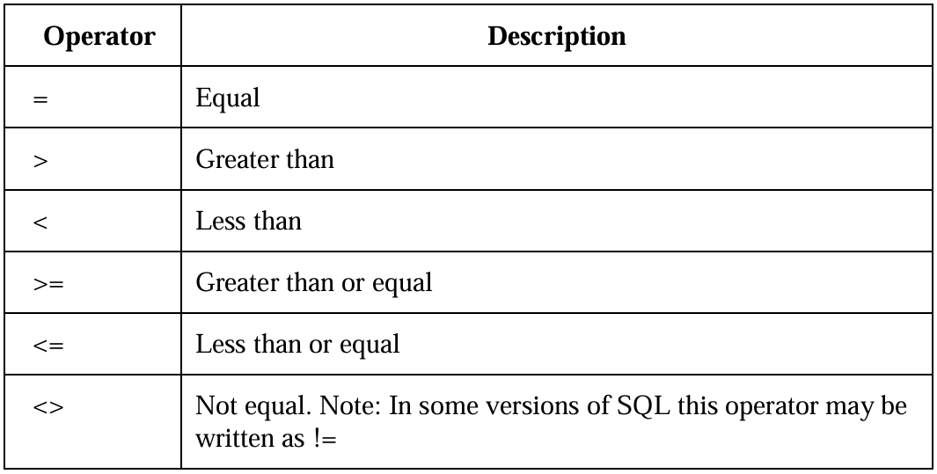
2.5 OPERATORS IN THE WHERE CLAUSE

Slide 43
2.5.1 SQL UPDATE Statement
The UPDATE statement changes data in existing rows either by adding new data or modifying existing data.
UPDATE Syntax
UPDATE table_name
SET column1 = value1, column2 = value2, ...
WHERE condition;
2.5.2 SQL DELETE Statement
The DELETE statement removes rows from a record set.
WHERE clause that limits the deletion to select records.
DELETE Syntax:
DELETE FROM table_name
WHERE condition;

Slide 44
The rules for the DELETE statement are:
If you omit a WHERE clause, all rows in the table are removed (except for indexes, the table, constraints).
DELETE cannot be used with a view that has a FROM clause naming more than one table.
Note: WHERE clause specifies which record(s) should be deleted.
2.5.3 SQL ORDER BY Keyword
The ORDER BY keyword is used to sort the result-set in ascending or descending order.
The ORDER BY keyword sorts the records in ascending order by default.
To sort the records in descending order, use the DESC keyword.
ORDER BY Syntax:
SELECT column1, column2, ...
FROM table_name
ORDER BY column ASC|DESC;

Slide 45
2.5.4 The SQL AND, OR and NOT Operators
The AND operator displays a record if all the conditions separated by AND are TRUE.
The OR operator displays a record if any of the conditions separated by OR is TRUE.
The NOT operator displays a record if the condition(s) is NOT TRUE.
Note: WHERE clause can be combined with AND, OR, and NOT operators.
AND Syntax:
SELECT column1, column2, ...
FROM table_name
WHERE condition1
AND condition2
AND condition3 ...;

Slide 46
OR Syntax:
SELECT column1, column2, ...
FROM table_name
WHERE condition1
OR condition2
OR condition3 ...;
NOT Syntax:
SELECT column1, column2, ...
FROM table_name
WHERE NOT condition;
2.5.5. Combining AND, OR and NOT with the SELECT Statement
The SQL AND condition and OR condition can be combined to test for multiple conditions in a SELECT statement.

Slide 47
The Syntax of using AND and OR operators
SELECT *
FROM table_name
WHERE condition1
AND condition2
OR condition_n;
2.6 SQL AGGREGATE FUNCTIONS
Access provides a variety of aggregate functions, including:
SUM, COUNT, AVG, Min and Max, etc..,
2.6.1 SQL COUNT Function
SELECT COUNT (age)
FROM student;

Slide 48
2.6.2. SQL MAX Function
SELECT MAX (age)
FROM student;
2.6.3 SQL MIN Function
SELECT MIN (age)
FROM student;
2.6.4 SQL AVG Function
SELECT AVG (age)
FROM student;
2.6.5 SQL SUM Function
SELECT SUM (age)
FROM student;
2.7 STRING EXPRESSIONS in SQL
2.7.1 LEFT FUNCTION
The syntax for the Left function in MS Access is:
LEFT (text, number_of_characters)
Text: The string that you wish to extract from.
number_of_characters: Indicates the number of characters starting from the left-most character.
Note: If number_of_characters exceeds the number of characters in text, the Left function will return text.
SELECT LEFT("RWANDANZIZA",4);

Slide 49
2.7.2 LEN FUNCTION
The Microsoft Access Len function returns the length of the specified string.
The syntax for the Len function in MS Access is:
SELECT Len("RWANDANZIZA");
2.7.3 UCase function
The Microsoft Access UCase function converts a string to all upper-case.
The syntax for the UCase function in MS Access is:
SELECT UCase("rwandanziza");
2.7.4 LCase function
The Microsoft Access LCase function converts a string to all upper-case.
The syntax for the LCase function in MS Access is:
SELECT Lcase("RWANDANZIZA");

Slide 50
2.7.5 StrReverse function
The syntax for the StrReverse function in MS Access is:
SELECT StrReverse("RWANDANZIZA");
2.7.6 The StrComp() function
The StrComp() function compares two strings.
The result is returned as an integer based on the comparison:
If string1 = string2, this function returns 0
If string1 < string2, this function returns -1
If string1 > string2, this function returns 1
If string1 or string2 is null, this function returns null
Syntax for StrComp ():
SELECT StrComp("gasabo", "Nyarugenge");

Slide 51
2.8 Data Control Language (DCL)
DCL commands are used to enforce database security in a multiple user database environment.
Two types of DCL commands are GRANT and REVOKE commands.
Only Database Administrator's or owners of the database object can provide/remove privileges on a database object.
2.8.1 SQL GRANT Command
The Syntax for the GRANT command is:
GRANT privilege_name
ON object_name
TO {user_name |PUBLIC |role_name}
[WITH GRANT OPTION];

Slide 52
privilege_name is the access right or privilege granted to the user. Some of the access rights are ALL, EXECUTE, and SELECT.
object_name is the name of a database object like TABLE, VIEW, STORED PROC and SEQUENCE.
user_name is the name of the user to whom an access right is being granted.
Public is used to grant access rights to all users.
Roles are a set of privileges grouped together.
With grant option allows a user to grant access rights to other users.
2.8. 2 SQL REVOKE Command
The REVOKE command removes user access rights or privileges to the database objects.
Syntax for the REVOKE command is:

Slide 53
REVOKE privilege_name
ON object_name
FROM {user_name |PUBLIC |role_name}
Privileges and Roles
Privileges defines the access rights provided to a user on a database object.
There are two types of privileges.
System privileges: This allows the user to CREATE, ALTER, or DROP database objects.
Object privileges: This allows the user to EXECUTE, SELECT, INSERT, UPDATE, or DELETE data from database objects to which the privileges apply.

Slide 54
UNIT 3 INTRODUCTION TO VISUAL BASIC
This unit will enable to build a simple desktop application for a real-life situation.
3.1. Event Oriented Programming using Visual Basic
3.1.1. General introduction
a. Visual Basic (VB) is an event-driven programming language and environment from Microsoft provides a Graphical User Interface (GUI) which allows programmers to modify code by simply dragging and dropping object and defining their behavior and appearance.
b. BASIC: means Beginners’ All-purpose Symbolic Instruction Code
c. Object-oriented programming (OOP): objects are the things you think about first in designing a program and they are also the units of code that are eventually derived from the process.

Slide 55
d. Graphical User Interface (GUI) is an interface through which a user interacts with electronic devices such as computers and smartphones.
3.1.2 Desktop application
A desktop application is a computer program that runs locally on a computer device, such as desktop or laptop computer, in contrast to a web application, which is delivered to a local device over the internet through browser from a remote server.
3.1.3 Difference between desktop and web applications
a. Desktop applications
They must be developed for and installed on a particular operating system.
Have strict hardware requirements that must be met to ensure that they function correctly.
Updates to the applications must be applied by the user directly to their installation, and may require hardware upgrades or other changes in order to work.

Slide 56
b. Web applications
A web application is any computer program that performs a specific function by using a web browser.
The user accesses the application using the web browser and works with resources available over the internet, including storage and CPU processing power.
This approach allows for thin clients (machines with limited hardware capabilities) to provide access to complex applications delivered from a centralized infrastructure.
c. Event oriented programming.
Event oriented programming is a paradigm in which the flow of program is determined by events, such as user actions (mouse clicks, key presses), sensor outputs or messages from other programs is commonly used in graphical user interfaces and other applications like Web applications, JavaScript, C#.

Slide 57
Visual Basic is Event oriented programming because of the following reasons:
The programmer needs to write code that performs some tasks in response to certain events.
Has events that occur by mouse clicking and moving or keyboard stokes (Some of the events are load, click, double click, drag and drop, pressing the keys and more.)
Focus on the use of Graphical User Interface.
The events usually comply but not limited to the user’s inputs.
The most important events for the form are described in the following table.
Click➔Single click on object
Dbclick ➔Double click on object
Load ➔ Loading the object

Slide 58
3.2. The Features of Visual Basic
It is easier for the user to minimize code writing.
The user will become more familiar with visual approach for other visual languages.
It provides Input box and Output box as interactive windows with user.
It is very easy program language compare with other.
3.2.1. Installation of Visual Basic
To install Visual Basic 6.0, you can first check if it is compatible with windows installed in the computer.
If you opt for installation Visual Basic 6.0, you have to save it on the storage memory like Flash disk, CD, DVD.
The installation procedure starts as follows:
1. Connect a storage device to the computer and open it
2. Right click Visual Basic setup
3. Click on setup

Slide 59
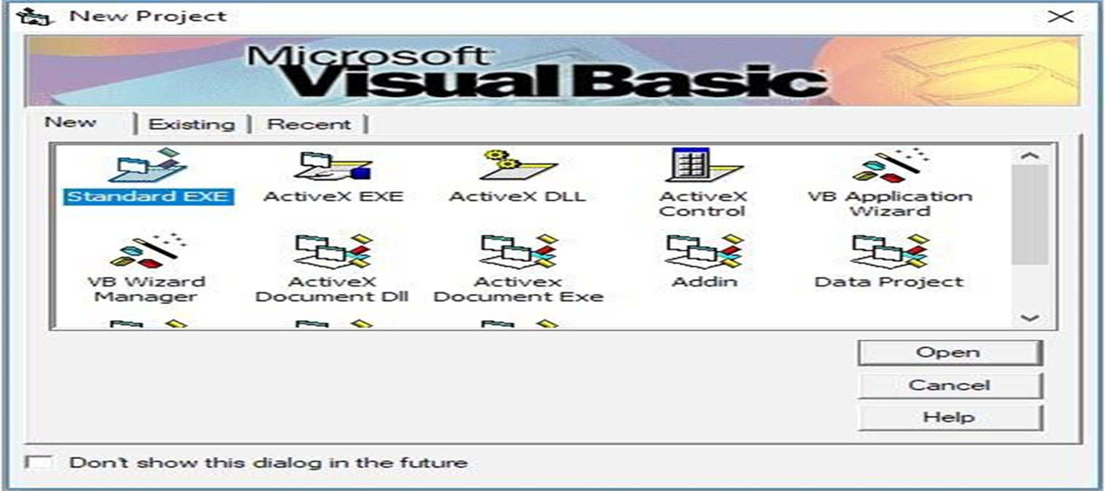
3.2.2. Visual Basic features:
1. Data Access Features: This allows programmers to develop database front end applications and server-side components for most popular database formats including MS SQL and other Databases.
2. Active X Technologies: That allows programmers to use the functionality provided by other applications, such as MS Office and other windows applications.
3. Internet capabilities make it easy to provide access to documents and applications across internet server applications.
4. Your finished application is a true executable (.exe) file that uses a Visual Basic Virtual Machine that you can freely distribute.
3.2.3. Standard EXE Visual Basic Application
1. Standard Exe project is a typical application in which can use the database manipulation.

Slide 60
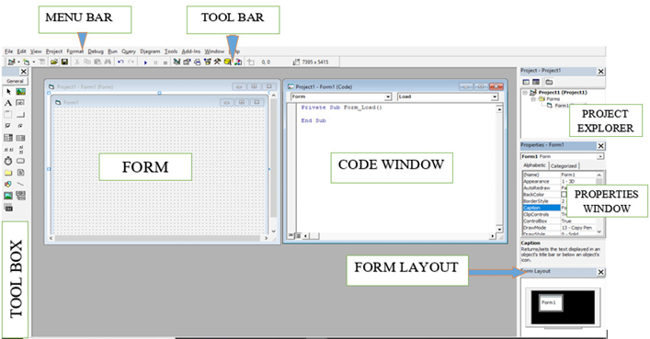
Standard EXE application is normally the most widely used among the available Project types in Visual Basic.
A standard EXE application is normally used when you want to develop a stand-alone application.
Examples: calculators, text editors, and other similar applications.
3.3. Visual Basic Standard EXE Integrated Development Environment (VB-IDE)

Slide 61
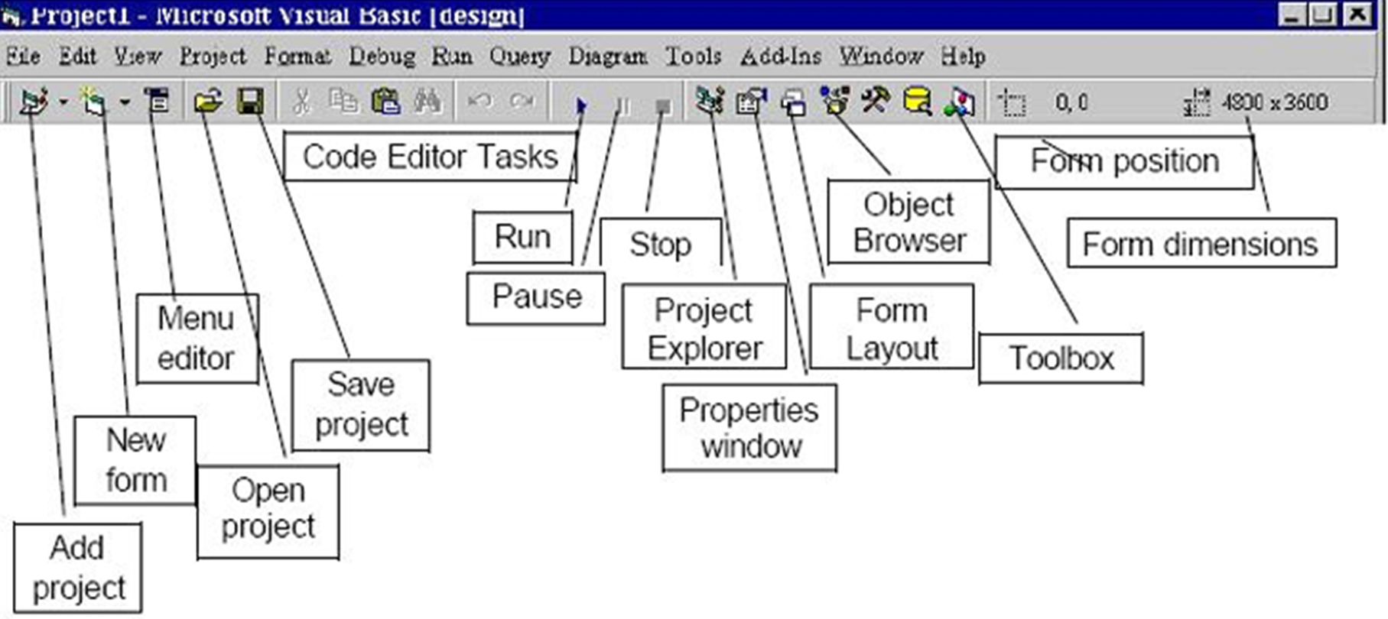
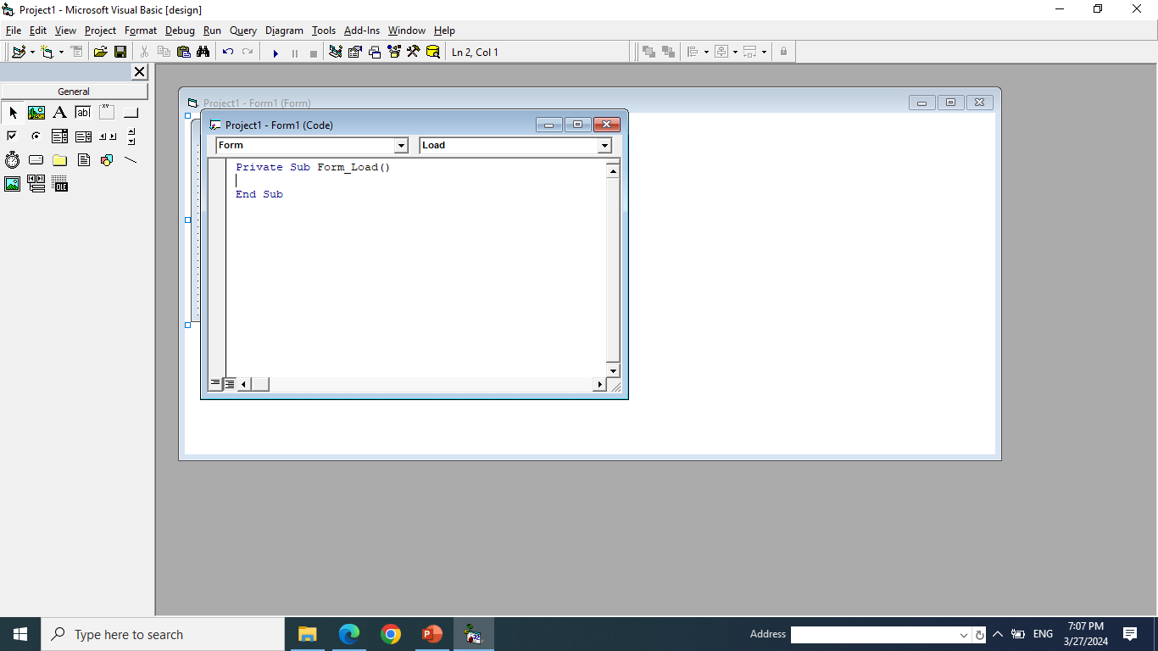
3.3.1. Visual Basic Integrated Development Environment
It is called integrated because we can access virtually all of the development tools that we need from one screen called interface.
The IDE is also commonly referred to as the design environment, or the program.
3.3.2. Menu Bar
3.3.3. Toolbar

Slide 62
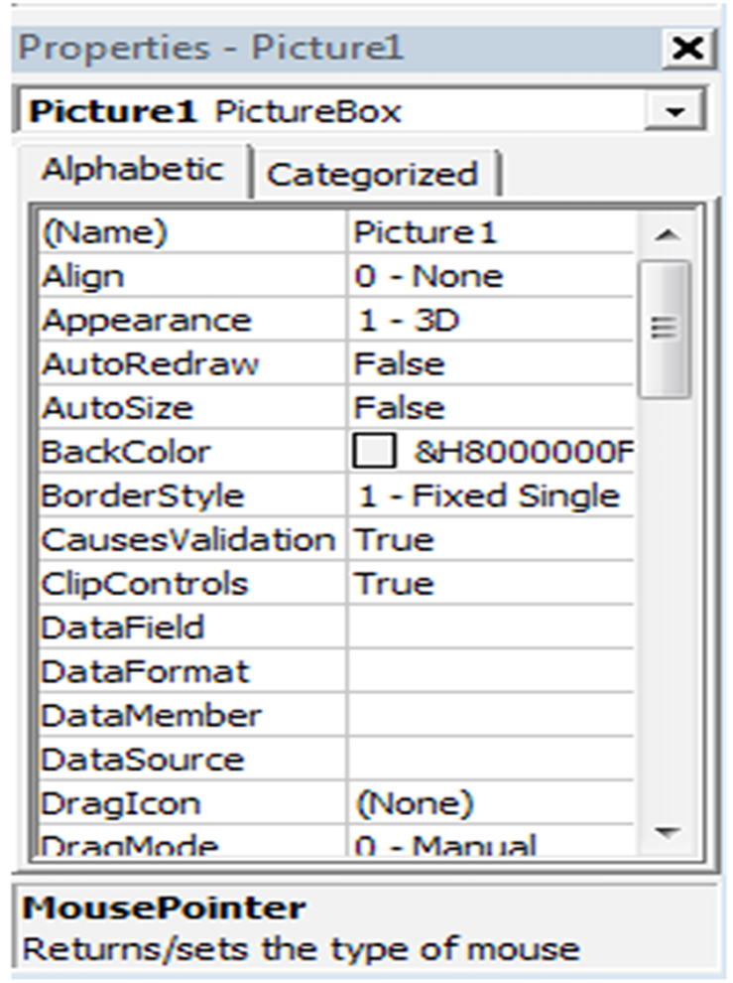
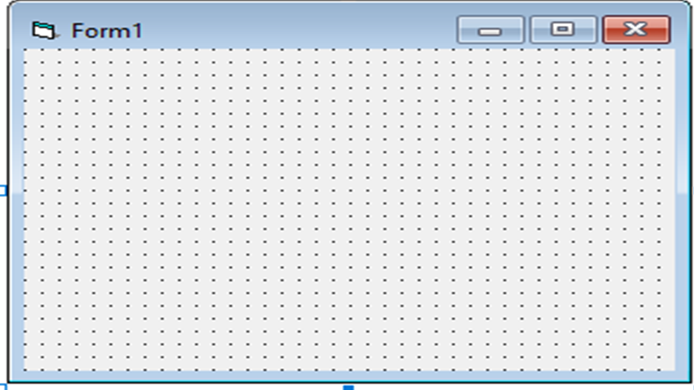
3.3.4. Form window
3.3.5. Properties Window
Properties Window is used to change the state of each control using particular properties associated with each control.

Slide 63
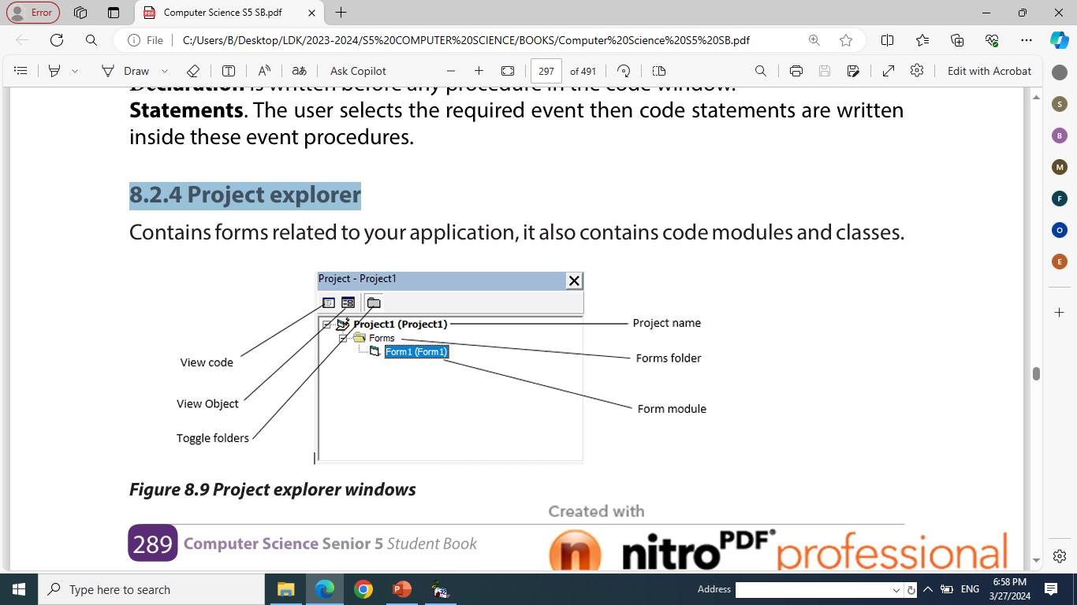
3.3.6 Project explorer

Slide 64
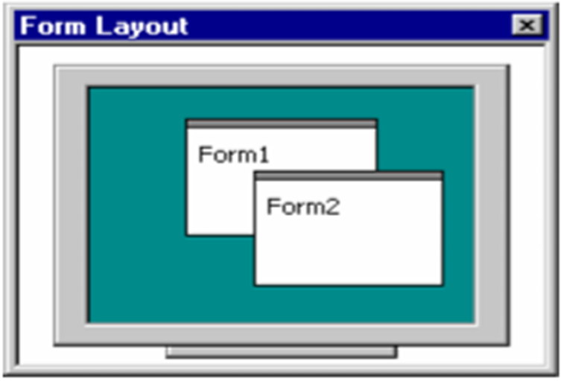
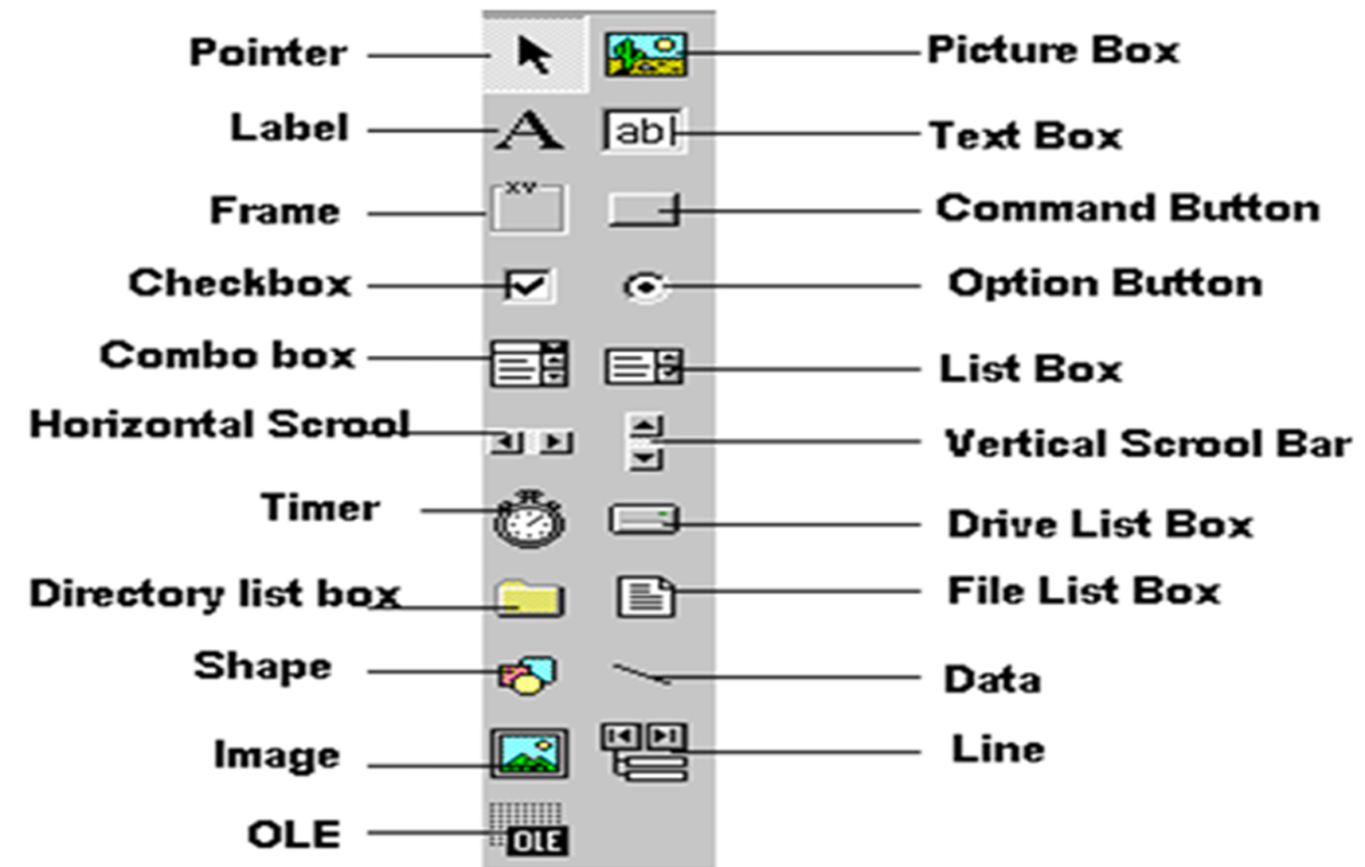
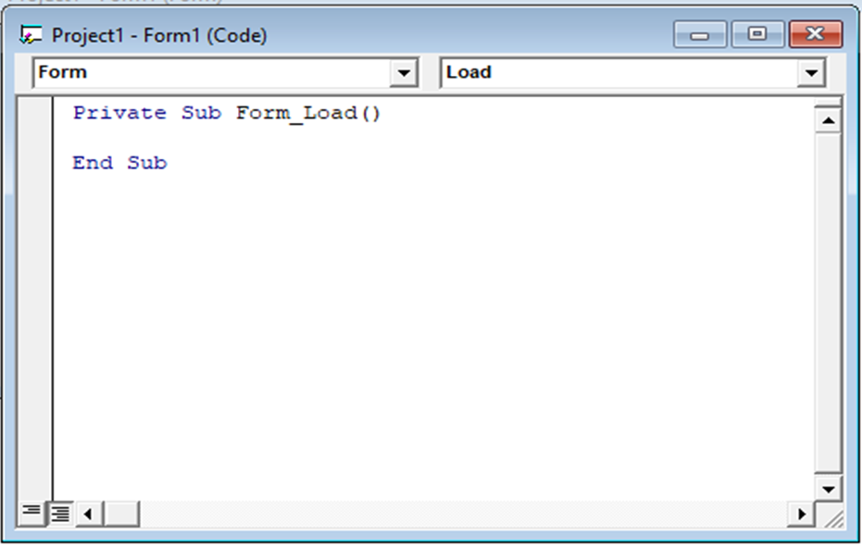
3.3.7 Form Layout Window
3.3.8 Code window or VB Editor
3.3.9. Tool Box

Slide 65
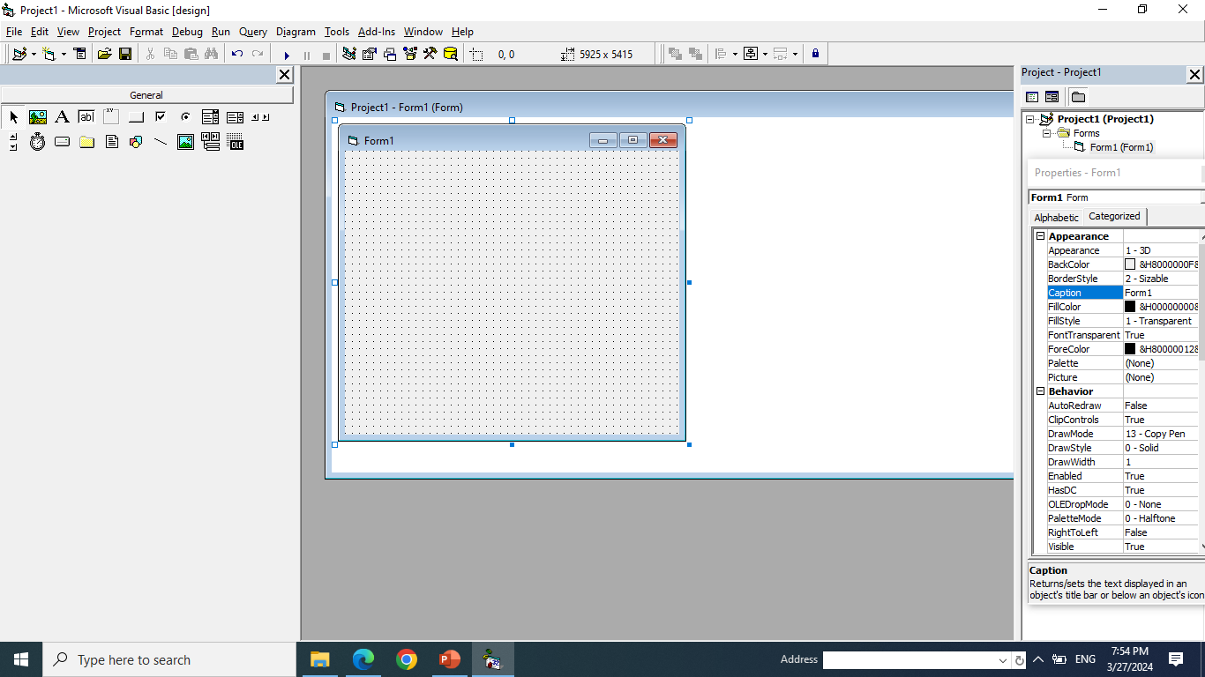
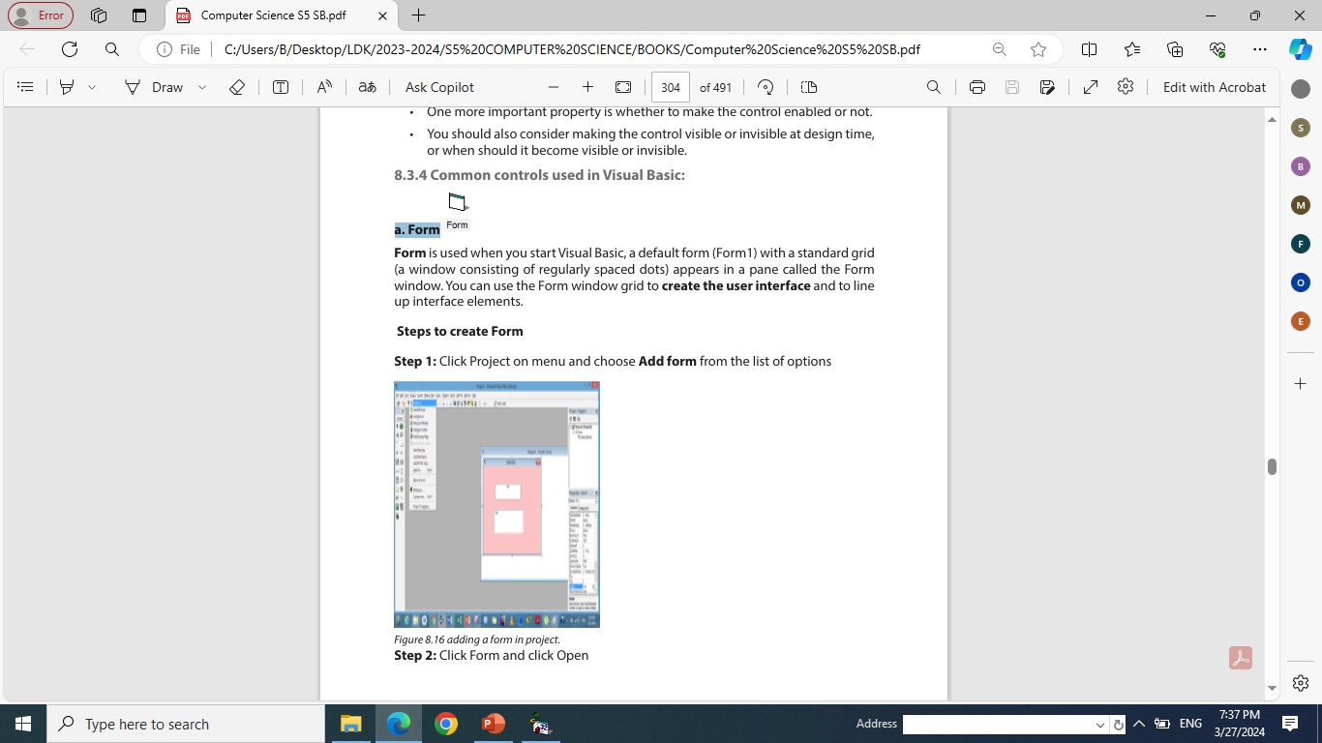
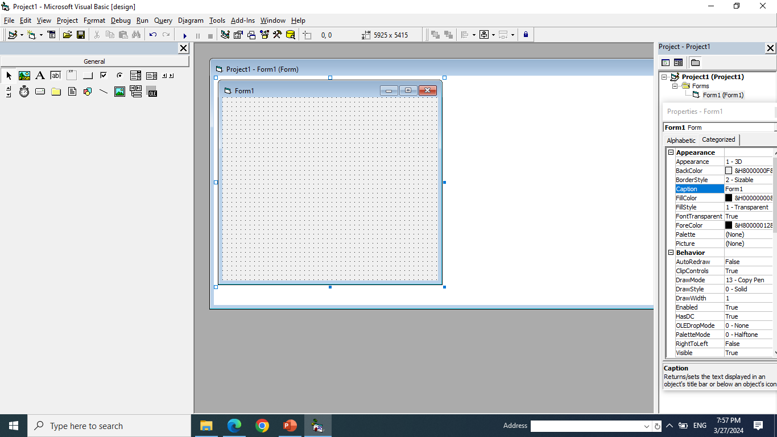
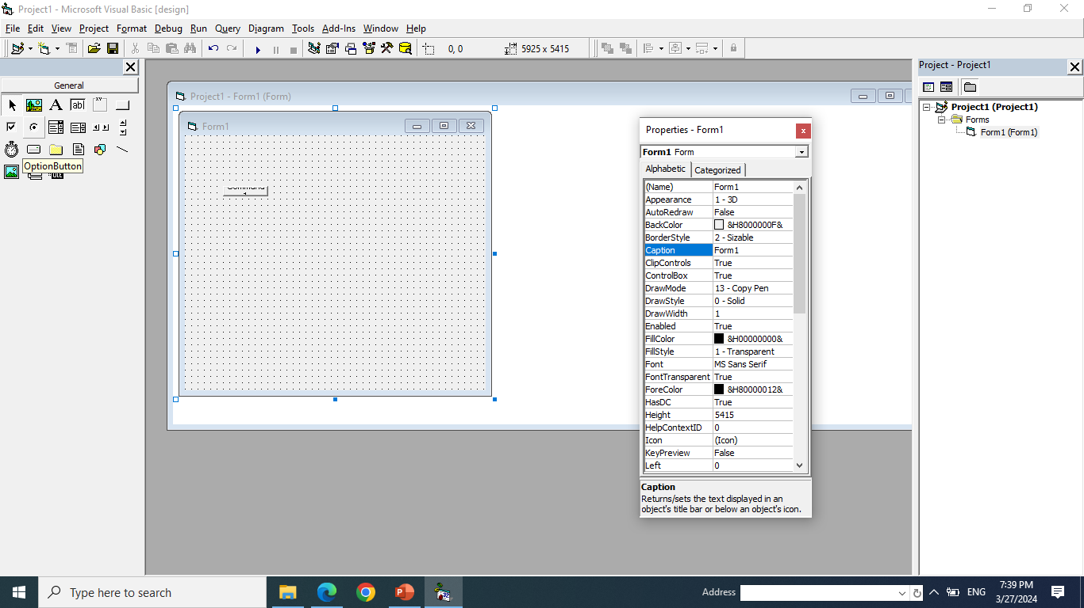

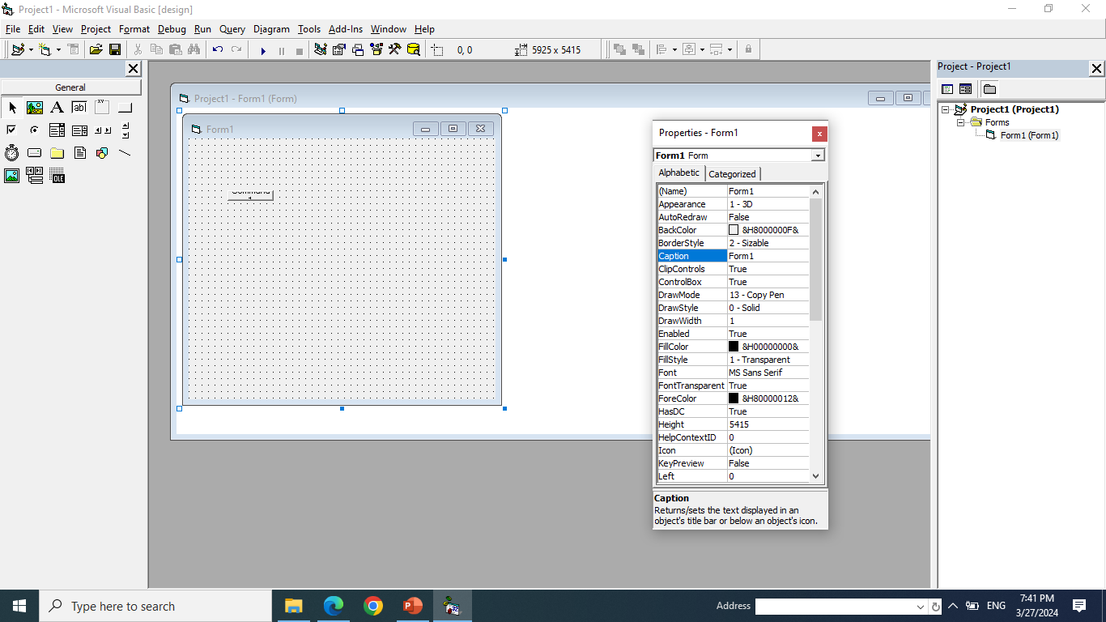

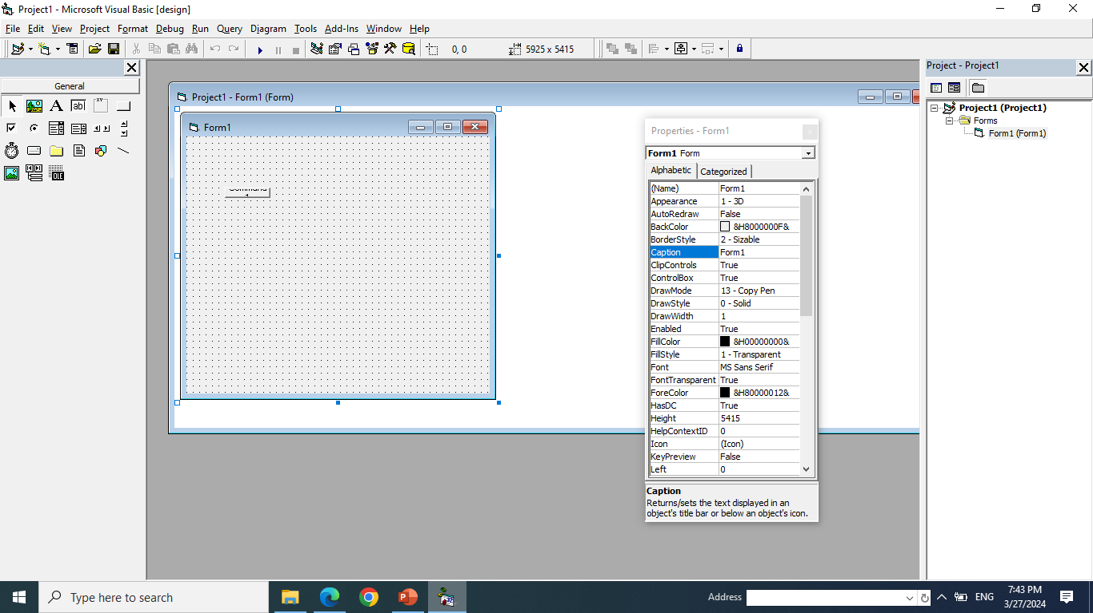



3.4 Common controls used in Visual Basic:
a. Form
b. Label
c. Text Box
d. Frame
e. Radio Buttons/ Option Buttons
f. Check box
g. Command button
h. List Box
i. Combo Box
j. Picture Box
l. Timer

Slide 66
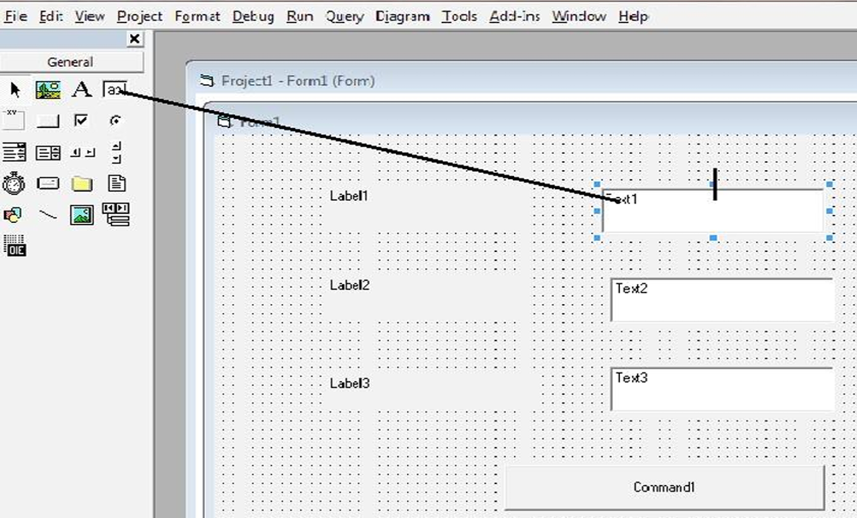
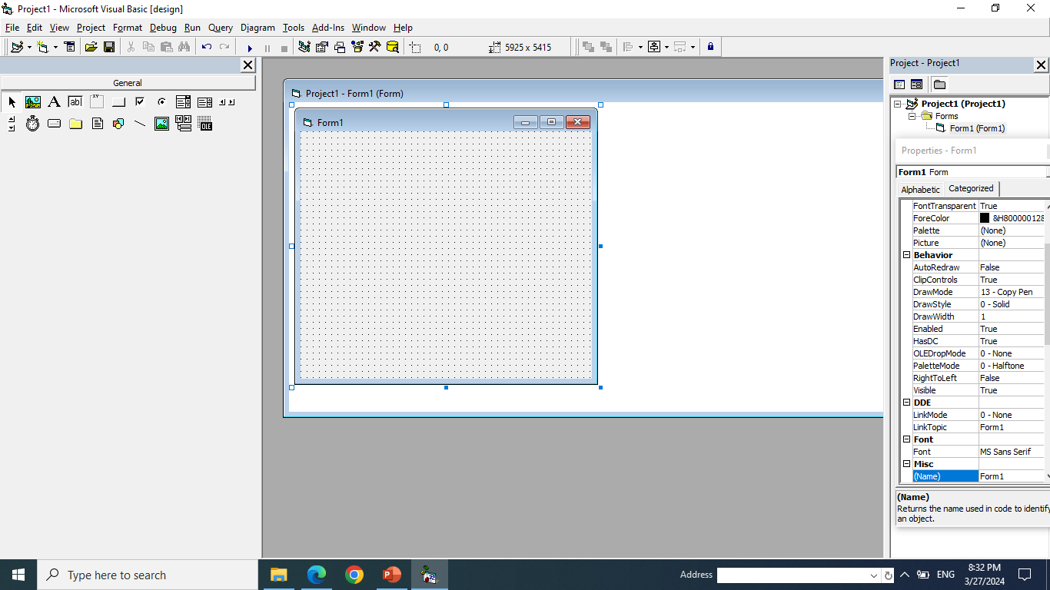


m. File System Controls
1) Drive List Box
Directory List Box
3) File List Box
To design a form in Visual Basic, use the controls which are available in the Tool Box in the left side of the project window.
Use the following steps for each control that you want to add on the form:
Step 1: In the Tool Box, choose a control that you want and Click on it.
Step 2: Drag and draw a control in the form using mouse.
Step 3: Change state for Specific control like size etc.

Slide 67
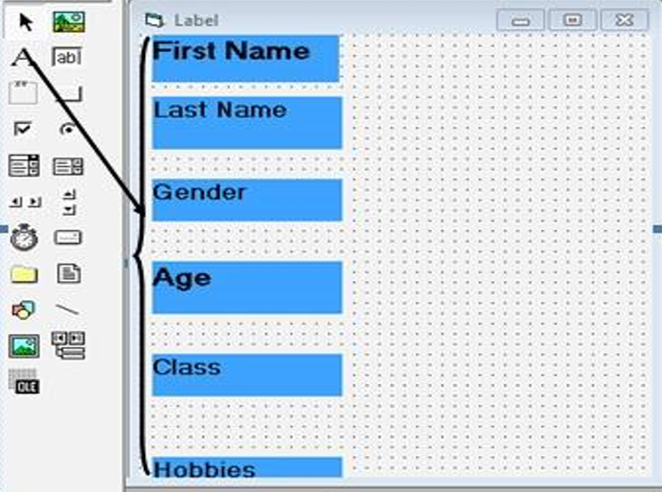
a. Form
Form is used when you start Visual Basic, a default form (Form1) appears in a pane called the Form window.
Steps to create a Form:
Step 1: Click Project on menu and choose Add form from the list of options
Step 2: Click Form and click Open
Step 3: Set the Properties for a Form
b. Label
The following are the steps to add a label on the form.
Step 1: Click on the label icon on the toolbox
Step 2: Drag and drop a label control in the form
Step 3: Set Properties for label

Slide 68
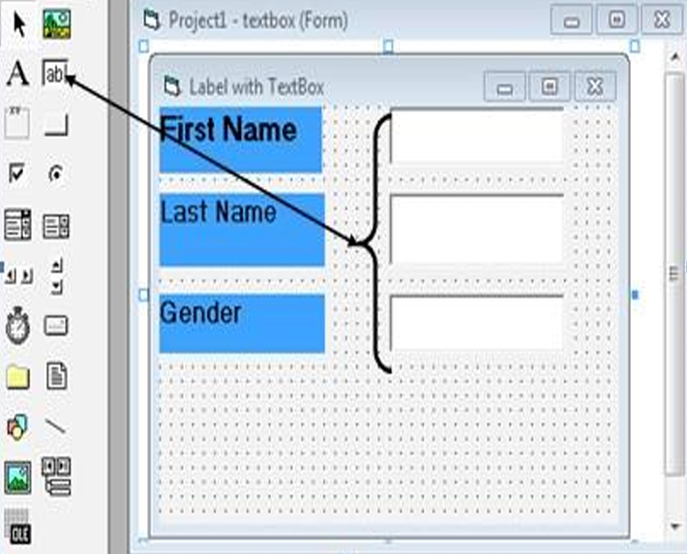
c. Text Box
The text box is the standard control that is used to receive input from the user as well as to display the output.
Steps to add Textbox
Step 1: Click on the Textbox icon In the toolbox
Step 2: Drag and drop a Textbox control in the form
Step 3: Set Properties for Textbox such as Name, alignment, appearance, etc.

Slide 69
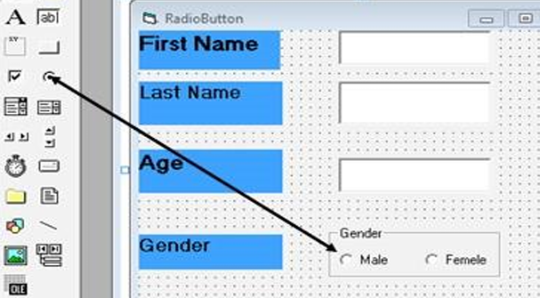
a. Radio Buttons/ Option Buttons
The Option Box control lets the user selects one of the choices.
In fact, only one Option Box can be selected at one time.
In computer terminology we call this mutual exclusion.
When an option box is selected, its value is set to True otherwise it is set to False.
Steps to add Option Button manually
Step 1: Click on the OptionButton icon on the toolbox
Step 2: Drag and drop an OptionButton control in the form
Step 3: Set Properties for Option Button

Slide 70
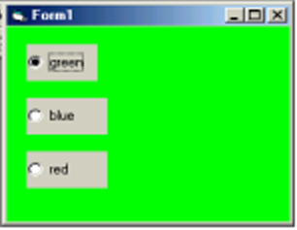

Steps to add Option Button manually
Example:
Design a form with three option buttons red, green and blue such that when we select an options the color of the form change.
Source code
Private Sub Option1_Click()
Form1.BackColor = vbGreen
End Sub
Private Sub Option2_Click()
Form1.BackColor = vbBlue
End Sub

Slide 71


Private Sub Option3_Click()
Form1.BackColor = vbRed
End Sub
3.5.1 Check box control
When the Check Box is checked, its value is set to 1 otherwise it is set to 0.
For example, the program will change the background color of the form to red when the check box is unchecked and it will change to blue when the check box is checked.
Steps to add CheckBox manually
Step 1: Click on the CheckBox icon on the toolbox
Step 2: Drag and drop a CheckBox control in the form
Step 3: Set Properties for CheckBox

Slide 72



Source code
Private Sub Check1_Click ()
Text1.FontBold = Check1.Value
End Sub
Private Sub Check2_Click ()
Text1.FontItalic = Check2.Value
End Sub
Private Sub Check3_Click ()
Text1.FontUnderline = Check3.Value
End Sub

Slide 73

3.5.2 Command button
To make the button functional, the user should add some code.
To do this: Double click on command tool then code form appears.

Slide 74

3.5.3. Image box
The Image Box is another control that handles images and pictures.
However, there is one difference, that an Image can be resized.
This feature is not available in the Picture Box.
The syntax is as follows:
Picture1.Picture = LoadPicture("C:\test.bmp")
3.5.4 Timer
When we need to perform tasks at regular interval, we can use Timer
Timer syntax:
Label1.Caption = Time

Slide 75

3.6. Controls in Visual Basic: ComboBox, ListBox and Drive
3.6.1. Combo Box
The function of the Combo Box is also to present a list of items where the user can click and select the items from the list.

Slide 76

3.6.2. List Box
The function of the List Box is to present a list of items where the user can click and select the items from the list.
In order to add items to the list, we can use the AddItem method.
ListBox.Item.Add(“Text”)
ListBox1.Items. Remove(“text”)
It is illustrated in the following example:
Private Sub Form1_Load (sender As Object, e As EventArgs)
ListBox1.Items. Remove (“Visual Basic 6”)
End Sub
List Box contains a list of options from which user can choose.
The Selected item in a ListBox is given by the Textproperty.

Slide 77

Adding items to the list
a) Change property list from properties window:
Open the list properties window and choose list property.
Write a list of items to appear in the list box

Slide 78

3.6.3 Drive List Box
The Drive ListBox is for displaying a list of drives available in your computer.

Slide 79

3.7. Controls in Visual Basic: Frame, Picture Box, File system and director list box
3.7.1. Frame
If you want to create a group of controls that work together, you must first create a frame for the controls.
Steps to add Frame:
Step 1: Click on the Frame icon on the toolbox
Step 2: Drag and drop a Frame control in the form
Step 3: Set Properties for Frame

Slide 80

3.7.2 Picture Box
You can load a picture at design phase by clicking on the picture item in the properties window and select the picture from the selected folder.
You can also load the picture at runtime using the LoadPicture method.
For example: the statement will load the picture grape.gif into the picture box.
Picture1.Picture=LoadPicture(“C:\Images\grape.gif”)
3.7.3. File System Controls
File system controls can be drive list box, directory list box and file list box.

Slide 81

3.7.4. Directory List Box
Directory List Box is for displaying the list of directories or folders in a selected drive.

Slide 82

3.7.5. File List Box
This control displays a list of files in the current folder.

Slide 83
3.8. Planning and Developing a Visual Basic program.
3.8.1. The process of Planning and Developing a Visual Basic program
a. Draw the interface
b. Set properties
c. Write the event code
You just have to write your code between two statements.
Example 1 a VB application to display the message:
Private sub Form_load()
Form1.show
Print”welcome to the world of programming”
End sub.

Slide 84
Example 2 VB application to display date, time and message
Private Sub Form_Load()
Form1.Show
Print “ my message”
Print “ today’s date is:” & Date
Print “ and the time is: “ & Time
Print “ thanks and bye.”
End Sub
3.9. VB Project Planning
3.9.1. Software requirement analysis
1. External Interface Requirements
a. User Interfaces
b. Hardware Interfaces
c. Software Interfaces

Slide 85
d. Communications Interfaces
3.9.2. Project 2: Front-end user interface in Visual Basic
In Visual Basic, the term Front End refers to the user interface, where the user interacts with the program through the use of the screen forms and reports.
3.9.3 Back-end database
Database systems are comprised of a Front End and Back End.
The Back End has the tables that store data, including the relationships between the tables.
3.10. Connecting a Visual Basic 6.0 project to a database by using ADO
ADO stands for ActiveX Data Object.
It is a Microsoft Active-X component that is automatically installed with Microsoft IIS (Internet Information Services).

Slide 86
The ADO is a programming interface that is used to access data in a database.
This icon may not appear in your Visual Basic toolbox.
If it doesn’t, select Project from the main menu, then click Components.
The Components window will appear.
Select Microsoft ADO Data Control, then click OK.
The control will be added to your toolbox.
3.10.1. ActiveX data Object (ADO)
This control helps us to access a database data offering the possibility of working on different data sources such as text files, relational database etc.
i. Add ADO control
ADO controls contain multitudes of objects having properties, methods and events.
Access-connection: It allows your program to access a data source using a connection.

Slide 87


ii. Record set:
This property work with the records which can be accessed by an ADO control.
Field Corresponds to the fields of a database which are connected to the program.
Error may occur when a program fails to connect, execute a command or perform a given operation.
Event ADO uses the concept of events as other VB interfaces do, you can use also event procedures.
Record source property specifies the source of the records accessible through bound controls on your form.
Data source property specifies an object containing data to be represented as a record set object.

Slide 88

iii. Required for connecting Visual Basic to database
Applications communicate with a database to retrieve data to the application or to insert, update or delete data after following the following steps:
Step 1. Create database tables in Microsoft access
Step 2. Design a Visual Basic Interface
Step 3. Data Control and Datagrid
3.10.2 Designing ADO Data Control 6.0 and DataGrid control 6.0
a. Right click under Tools Box Button
b. Click on Components
c. Activate microsoft ADO Data Control 6.0 (OLEDB) and microsoft DataGrid control 6.0(OLEDB)

Slide 89

From tools Box design ADO Data Control 6.0 (OLEDB) and DataGrid control 6.0 (OLEDB) drown by using their tools.

Slide 90

3.11. Connecting ADODC control to the tables within Access database
A visual basic database application has three main parts:
The user interface is where a user interacts with the application.
The database engine Connects the application program with the physical database files.
The data storage is the source of the data. It may be a database or a text file.
3.11.1. ADODC to database
The ADODC or Active Data Objects Data Control allows us to put controls, such as labels, text boxes, list boxes and other display controls, on a form and connect them to the Data Control, which then connects to a database.
Follow the steps below to connect the database:
a. Right click Ododc1 control
b. Left click on Adodc1 properties
c. On use Connecting String click on Build

Slide 91


d. Click on Apply
e. Select Microsoft Jet 4.0 OLEDB Provider
f. Click on next
g. On Select or enter a database name Click on three dots (reflesh)

Slide 92

h. Select the name of database save in 2000 Format
i. Click on OPEN
j. Click on Test
k. Click on OK and Then OK

Slide 93

3.11.2. To connect Adodc to the tables in database
When ADODC is connected to the database the next step is to connect to ADODC to the table created in database
a. Right click on Adodc1
b. Click on Adodc Properties
c. Click on RecordSource

Slide 94

d. In Command Type, Select adCmdTable
e. In Table or Stored Procedure Name, select Table Name
f. Click on Apply and Then Click on Ok
3.11.2 Connect DataGrid control to the tables within Access database
a. Click on DataGrid control designed in in Visual Basic interface
b. In properties click on DataSource
c. Select Adodc1

Slide 95

3.11.3. Connect Text box controls to the tables Columns within Access database
1. Click on Text box of Client ID
2. In Properties interface click on DataSource and select Adodc1

Slide 96

3. In DataFiel , select ID
NB: Apply the above steps to all Text box designed into Visual Basic interface
3.11.4. Program Coding in command buttons
programming or writing program code is the means used to cause something to happen when an event, such as a button click occurs.
a. Adding new records
Use the AddNew method to create
And add a new record in the Recordset object named by recordset.

Slide 97


b. Saving records
It allows to save the data according to the new values of the fields of a table
c. Delete records
After deleting a record, the deleted record remains current until you move to a different record.

Slide 98
3.12 Building the interface and accessing the database
3.12.1. Interface and accessing the database
Drawing the interface, you have to set properties and then coding
You have to add the data control to connect your database.
3.12.2. Principles for designing a friendly and ergonomic user interface
Interface is required to access a related database in order a user can add, modify, retrieve data and so many other interactions.
Add data control to be used to connect database
3.12.3. Ergonomic user interface
Designing a good user interface is an iterative process.
There are appropriate techniques to use during the designing and implementation of a user interface.

Slide 99
a. Principles of a friendly user interface
The main principles of a friendly user interface.
b. Principles for an ergonomic user interface
Ergonomics derives from two Greek words: ergon, meaning work, and nomoi, meaning natural laws, to create a word that means the science of work and a person’s relationship to that work.
Ergonomics is a field of study that attempts to reduce strain, fatigue, and injuries by improving product design and workspace arrangement.
There are five aspects of ergonomics: safety, comfort, ease of use, productivity/performance, and aesthetics.

Slide 100
Safety: This has to do with the ability to use a device or work with a device without short- or long-term damage to parts of the body.
Comfort: Comfort in the human-machine interface is usually noticed first.
Ease of use: This has to do with the ability to use a device with no stress
Productivity/performance: Ergonomics addresses the performance of user interface by providing more options to the users, enabling them to easily and quickly skip some instructions as users’ choice.
Aesthetics: Signs in the workplace should be made consistent throughout the workplace to not only be aesthetically pleasing, but also so that information is easily accessible.

Slide 101
UNIT 4: INTRODUCTION TO WEB DESIGNING
4.1. Introduction to web designing
In this unit, we discuss basic concepts relating to web designing such as website, web page, web application, static web page and dynamic web page.
The step-by-step process of developing a website is also discussed here.
4.1.1. Understanding of basic concepts
4.1.1.1. Key terms
i. Website
A website is a collection of several web pages that contain information on particular subject.

Slide 102


ii. Web page
A web page is a document commonly written in HTML (Hypertext Markup Language) containing more specific information that is accessible through the internet or other networks using an internet browser.
A web page is hypertext document that incorporates content such as text, images, sound, video and so on.
iii. Web application
A Web application (Web app) is an application program that is stored on a remote server and delivered over the internet through a browser interface.
A web application is a software or program which is accessible using any web browser.
Below are the prime difference between web application and website:

Slide 103
iv. Static web page
A static page is one that is usually written in plain HTML and what is in the code of the page is what is displayed to the user.
v. A dynamic webpage
The dynamic web pages are employed where the information changes very often such as stock prices, weather information, news and sports updates.
There are several tools used for the creation of dynamic web pages.
For example:
PHP: Personal Home Page
CGI: Common Gateway Interface
ASP: Active Server Pages
JSP: Java Server Pages
AJAX: Asynchronous JavaScript and XML
etc.

Slide 104

Key differences between Statistic and Dynamic Web Pages

Slide 105
4.2 Introduction and evolution of HTML
4.2.1 Introduction to HTML
The idea behind hypertext is that instead of reading text in a linear structure like in a book, you can easily jump from one point to another based on interests.
Hypertext Markup Language (HTML) refers to a language used to structure hypertext (web) documents for presentation on the World Wide Web.
HTML is not a programming language but can be thought of as a presentation language used to instruct the browser on how to present text and multimedia content on the Web.
HTML is the standard markup language for creating Web pages.
4.2.2 Evolution of HTML
The HTML was invented by Tim-Berners Lee, the founder of World Wide Web.
Lee’s original HTML version was based on a more complicated document processing language known as Standard Generalized Markup Language (SGML).

Slide 106
Soon, Lee released different versions of HTML causing incompatibilities between different developers using different versions.
For this reason, the following was done:
A consortium known as World Wide Web Consortium (W3C) was established to standardize HTML.
The first standard version of HTML that was developed and maintained by W3C was HTML 2.0 released in 1995.
In 1996, release of HTML 3.2 standard then later HTML 4.0 in 1997.
Most web browsers today support variation of HTML known as Extensible Hypertext Markup Language (XHTML) that support mobile web application too.
Today, there is HTML5 which many browsers and developers are using to develop web applications.

Slide 107
HTML tags are element names surrounded by angle brackets or Less Than and Greater Than symbols (< >).
Syntax: <tag_name>content goes here...</tag_name>
Example: <title> login page<title>
HTML tags normally come in pairs like <p> and </p>
The first tag in a pair is the start tag, the second tag is the end tag
Note: The start tag is also called the opening tag, and the end tag the closing tag.
An attribute is used to define the property or characteristics of an element inside the element’s opening tag.
For example, a paragraph may be right aligned using align attribute as follows:

Slide 108
<p align=” left “> This is left aligned </p>
4.3.1 HTML Syntax and HTML Page Structure
Below is a visualization of an HTML page structure:
<html>
<head>
Document header related tags
</head>
<body>
Document body related tags
</body>
<html>

Slide 109
Example: the following sample HTML code creates a web page that displays "VISIT RWANDA Web Page":
<! DOCTYPE html>
<html>
<head>
<title>Page Title</title>
</head>
<body>
<h1>VISIT RWANDA Web Page</h1>
</body>
</html>

Slide 110
4.4 Design a static web page using html tags and hyperlinks
The editor that is going to be used for designing web pages is Notepad.
Step 1: Open Notepad
Step 2: Write HTML into Notepad.
The text below is tags for our web page.
<! DOCTYPE html>
<html>
<head>
<title>First page</title>
</head>
<body>
<h1>VISIT RWANDA Web Page</h1>
</body>
</html>

Slide 111
Step 3: Save the HTML Page.
You can use either .htm or .html as file extension.
Step 4: View HTML Page in a web browser.
HTML Links - Hyperlinks
You can click on a link and jump to another document.
Note: A link does not have to be text. It can be an image or any other HTML element.
HTML Links - Syntax
Hyperlinks are defined with the HTML tag:
<a href=”url”>link text</a>
Example:
<a href=”https://www.rra.gov.rw”>Visit Official Rwanda Revenue website </a>

Slide 112
4.4.1. Tags that identify and name documents
HTML language specification defines the markup that can be used to create a webpage, the webpage author decides which elements they will use to markup content.
For example:
a) The appearance (formatting) tags
A document heading may be created by making text larger, bold and with a different color.
Presentational markup for such a heading may look like this:
<p>
< font size=”36” color=”red” >
<b>ICT is a key of development </b>
</font>
</p>

Slide 113

The table below shows html tags formatting elements:

Slide 114

Example: The HTML document below shows how to use formatting tags
<!DOCTYPE html>
<html>
<head>
<title>Formatting elements</title>
</head>
<body>
<mark><b>Rwanda has 4 provinces and Kigali City</b></mark> <br>
<strong>Kigali City has 3 districts</strong><sup> which ones?</sup><br>
<del>Kigali Convention Center is in Nyarugenge district</del><br>
<ins>Thank you! </ins>
</body>
</html>

Slide 115
b) Heading tags
Heading tags are used in the body section to define section headings that stand out from the rest of the text.
HTML provided six levels of section headings: <h1>, <h2>, <h3>, <h4>, <h5>, and <h6>.
Example:
<!DOCTYPE html>
<html>
<head>
<title>Heading Example</title>
</head>

Slide 116

<body>
<h1>This is heading 1</h1>
<h2>This is heading 2</h2>
<h3>This is heading 3</h3>
<h4>This is heading 4</h4>
<h5>This is heading 5</h5>
<h6>This is heading 6</h6>
</body>
</html>
c) HTML images
The general syntax for inserting a graphical object or image is:
<img src=”Image URL ... attributes-list”/>

Slide 117

For example, the following HTML code displays an image called Volcano:
<!DOCTYPE html>
<html>
<head>
<title> Visit Rwanda </title>
</head>
<body>
<p><Strong><font color="red" size=48> Visit Volcanoes National Park </font> </strong></p>
<center><img src="volcano.png"alt="Gorilla in Rwanda" /> </center>
</body>
</html>

Slide 118
Setting Image size
For example:
<img src=”volcano.png” width =“80%” height=”90%” alt=”Gorilla in Rwanda” />
Image Alignment
For example:
<img src=“volcano.png” align=“top” alt=“Gorilla in Rwanda” />
Notice: with HTML it is possible to set page background color.
For example:
<! DOCTYPE html>
<html>
<head>
<title>First page</title>
</head>

Slide 119

<body bgcolor="yellow">
<h1><font color="red" size="72">
This page has a yellow color as page background! </h1>
</body>
</html>
4.4.2. Tags that organize web page contents
In this section, we discuss some HTML elements that describe the structure and organize web contents.
A. HTML lists: Ordered and Unordered list

Slide 120
HTML supports three types of lists namely ordered list, unordered list, and definition list.
Ordered list <ol> is a container for enumerated items ordered using numbers such as 1, 2, 3.
Unordered list <ul> is a collection of related items that have no special order or sequence.
Definition list <dl> is used for definitions such as glossaries that pair each label with some kind of description.
Example:
<!DOCTYPE html>
<html>
<head>
<title>Numbered List</title>
</head>
<body>

Slide 121

<p><Strong><font color=”red” size=72>
Easter African Community (EAC) has 6 Partner States:
</font></strong></p>
<ol >
<li>Rwanda</li>
<li>Uganda</li>
<li>Burundi </li>
<li>Kenya</li>
<li>Tanzania</li>
<li>South Sudan</li>
</ol>
</body>
</html>

Slide 122
It is possible to customize the numbering style of an ordered list using the type attributes as follows:
<ol type = “counter-type”>....</ol>
Examples
<ol type = “a”> ...</ol>
<ol type = “i”> ...</ol>
Creating unordered list
Unordered list is similar to ordered list only that the items are listed using bullets.
Example:
<!DOCTYPE html>
<html>
<head>
<title> Unordered List </title>
</head>

Slide 123

<body>
<p> <Strong> <font color=”purple” size=72>
Rwanda currently has 3 National Parks: </font> </strong> </p>
<ul>
<li> Volcanoes National Park Rwanda </li>
<li> Nyungwe Forest National Park </li>
<li> Akagera National Park </li>
</ul>
</body>
</html>

Slide 124
It is possible to customize unordered lists using type attribute and values that denote bullet types such as disc, square, or circle.
For example:
<ul type = “bullet-type”>....</ul>
<ul type = “square”> ..</ul>
B. HTML lists: Definition and Nested list
i. Creating definition list
A definition list is used to present a glossary of terms, or other definition lists like
Dictionary and encyclopedia.
To create a definition list, use <dl> ...</dl> element in which you place
<dt> ... </dt> to mark up the term and
<dd> ... </ dd> to mark up the definition part.

Slide 125
Therefore, a definition list consists of the following parts:
<dl> - Defines the start of the list
<dt> - A term
<dd> - Term definition
</dl> - Defines the end of the list
For example:
<!DOCTYPE html>
<html>
<head>
<title>Definition list </title>
</head>

Slide 126

<body>
<dl>
<dt><b>ICT </b></dt>
<dd>ICT stands for Information and Communication Technology</dd>
<dt><b>HTML</b></dt>
<dd> HTML stands for Hyper Text Markup Language</dd>
<dt><b>JPEG</b></dt>
<dd>JPEG stands for Joint Photographic Experts Group</dd>
<dt><b>CSS</b></dt>
<dd>CSS stands for Cascading Style Sheet</dd>
</dl>
</body>
</html>

Slide 127

Exercise write HTML tags for creating the following page

Slide 128
C. HTML Frame and Table tags
HTML Frame Tags
In the context of a web browser, a frame is a part of a web page or browser window which displays content independent of its container, with the ability to load content independently.
Frameset:
In HTML, a frameset is a group of named frames to which web pages and media can be directed.
The attributes rows and cols on the opening frameset tag define the dimensions of a grid of frames using comma-separated lists of sizes, specified in either pixels or percentages.
Within the frameset, a series of frame elements describe the initial source documents for each frame in the frameset, as well as assigning them names for use as the target of links.
Note that a HTML document would normally contain a head and a body may instead contain a head and a frameset (but not both a body and a frameset).
Example: the HTML document below, is creating three horizontal frames:

Slide 129

<! DOCTYPE html>
<html>
<head>
<title>Frames</title>
</head>
<frameset rows=”25%,40%,35%”>
<frame name=”top” src=”Unordered.html” />
<frame name=”main” src=”Visit.html” />
<frame name=”bottom” src=”Easter_Africa.html” />
</frameset>
</html>

Slide 130
HTML Table tags
The HTML tables are created using the <table> tag which is a container for <tr> (table row) tag used to create rows and <td> (table data) tag used to create data cells.
Before creating a table, consider the following table-features:
Caption: indicates the type of data presented in the table
Table headings: the row that indicate the data displayed in each column
To create a table, we use <table>…</table> tags:
<caption>…</caption> used to create the table caption
<th> ...</th> tag is used to create the table heading
<tr>...</tr> tag is used to create table rows
<td>...</td> tag is used to create data cells

Slide 131
<!DOCTYPE html>
<html>
<head>
<title>Table </title>
</head>
<body>
<table border=”2” cellpadding=”3” cellspacing=”3”>
<Caption><b> UMUCYO HOTEL EMPLOYEE’S DATA</b></caption>
<tr> <th>Employee Name</th> <th>Department</th> <th>Salary</th>
</tr>
<tr>
<td>Paul KAMANA</td> <td>Finance </td> <td>250000</td>
</tr>

Slide 132

<tr>
<td>Dhalie NIZEYIMANA</td> <td>Marketing</td> <td>200000</td>
</tr>
<tr>
<td>Jean Claude UWIHANGANYE</td> <td>Information Technology </td>
<td>400000</td>
</tr>
</table>
</body>
</html>

Slide 133
The following are basic attributes used to define or format a HTML table:
a) Border Attribute
If 0 is used, the border is invisible.
In our example above, the statement below creates a border of 2-pixel thickness.
<table border=“2” >
b) Height and Width attributes
To set the size of the table, use width and height attributes.
For example, the statement below sets the table size to width of 400 pixels and height of 150 pixels.
<table border=“2” width=“400” height=“150”>
c) Cellpadding Attribute
The cellpadding attribute specifies the space, in pixels, between the cell wall and the cell content.
Note: Do not confuse this with the cellspacing attribute, which specifies the space between cells.

Slide 134
Syntax: <table cellpadding=”pixels”>
d) Cellspacing Attribute
The cellspacing attribute specifies the space, in pixels, between cells.
Syntax: <table cellspacing=“pixels”>
Note: The cellspacing attribute of <table> is not supported in HTML5.
e) Table Caption
The caption tag will serve as a title or explanation for the table and it shows up at the top of the table.
f) Colspan attribute
The colspan attribute in HTML specifies the number of columns a cell should span. It is similar to merge cell in the spreadsheet program like Excel.
Syntax: <td colspan =“value”> table content...</td>

Slide 135
<th>: The colspan attribute when used with <th> tag determines the number of header cells it should span.
Syntax: <th cospan =”number”> table content...</th>
g) Rowspan attribute
The rowspan attribute in HTML specifies the number of rows a cell should span.
Syntax: <td rowspan = "value"> table content...</td>
<!DOCTYPE html>
<html>
<head>
<title>Table attributes </title>
</head>

Slide 136
<body>
<table border="4" cellpadding="3" cellspacing="3" width="400“ height="200">
<Caption><b> ECOLE SECONDAIRE DE MUHAMBARA</b></caption>
<tr>
<th colspan=6> Number of studens in E.S.M</th>
</tr>
<tr>
<th colspan=2> O'level</th>
<th colspan=2> A'level</th>
<th colspan=2> Total number</th>
</tr>

Slide 137

<tr>
<th>Boys</th>
<th>Girls</th>
<th>Boys</th>
<th>Girls</th>
<th rowspan="2">605</th>
</tr>
<tr>
<td>120</td>
<td>200</td>
<td>130</td>
<td>155</td>
</tr>
</table>
</body>
</html>

Slide 138
D. HTML Forms
When users fill forms and clicks the submit button, the data keyed into the form is sent (posted) to the web server for processing or storage into a database.
To create HTML forms, we use the <form> ... <form> element as follows:
<form action="Script URL“ method="GET|POST">
form elements like input, textarea etc.
</form>
The most common controls used in form include:
text, text area, select, radio buttons, checkboxes, file select, command button and reset buttons.
a) Form Action Attribute
The action attribute is used to specify the file on the server that receives data from the form for processing.

Slide 139
For example, the action attribute in the form tag below specifies a file named register.php that receives registration details after the user clicks the submit button:
<form action=“register.php”> </form>
b) Form Method Attribute
The Method attribute specifies how the data is to be sent to the web server.
The method attribute specifies the HTTP method (GET or POST) to be used when submitting the forms.
Get Method: If a GET method is used, the data supplied in the form is appended at the end of the URL.
Note that using Get method in login form is not recommended because unauthorized users may see actual username and password.
Post Method: Unlike the GET method, post method does not display submitted form data on URL because the parameters are passed as body of a HTTP request.

Slide 140

Use POST if the form is updating data, or includes sensitive information (password).
c) Text input
<input type="text"> defines a one-line input field for text input
For example:
First name: <input type=“text” name=“first” size = “20” />
This is how the HTML code above will be displayed in a browser:
d) Hidden input
To create hidden input, set the input type to hidden as shown below:
<input type=“hidden” name=“userid” value=“321”/>
e) Password input
<input type="password"> defines a password field:

Slide 141


<form>
User name:<br>
<input type="text" name="username"> <br>
User password:<br>
<input type="password" name="psw">
</form>
The HTML code above will display the following:
f) Textarea
The attributes used with textarea tag are: name, rows, and cols.
For example:
<form >
Comments: <br >
<textarea rows="7" cols="25" name="comment"> </textarea>
</form>

Slide 142

g) Checkbox
<! DOCTYPE html>
<HTML>
<HEAD> <TITLE> Checkbox </TITLE> </HEAD>
<BODY>
<P><Strong><font color="orange" size=36> Choose your favorite Games </font> </strong></p>
<form>
<p><input type="checkbox" name="game" checked="checked"> Football </p>
<p><input type="checkbox" name="game" > Basketball <p>
<p><input type="checkbox" name="game" > Volley Ball<p>
<p><input type="checkbox" name="game" > Net Ball<p>
</form>
</BODY>
</HTML>

Slide 143

h) Radio button
<input type="radio"> defines a radio button.
Example:
<!DOCTYPE html>
<HTML>
<HEAD> <TITLE>radio buttons</TITLE>
</HEAD>
<BODY>
<P><Strong> <font color= "orange" size=36> Select your sex </font> </strong> </p>
<form>
<input type="radio" name="sex" value="male" checked="checked" > Male </br>
<input type="radio“ name="sex" value="female">Female </br>
</form>
</BODY>
</HTML>

Slide 144
i) Select or (Drop-Down List)
For example:
<! DOCTYPE html>
<HTML>
<HEAD><TITLE>Dropdown list</TITLE>
</HEAD>
<BODY>
<P>
<Strong>
<font color="pink" size=36>
Select your residence province:
</font>
</strong>
</p>

Slide 145


<form>
<select name="dropdown">
<option value="Kigali" selected> Kigali City </option>
<option value="South"> South Province </option>
<option value="North"> North Province </option>
<option value="Easter"> East Province </option>
<option value="West"> West Province </option>
</select>
</form>
</BODY>
</HTML>

Slide 146



j) Submit and Reset Button
<form>
<input type="submit" name="submit" value="Send" />
<input type="reset" name="reset" value="Reset" />
</form>
Exercise: write the HTML tags for the next web pages:

Slide 147

Particularities of HTML 5
HTML5 is the fifth revised and newest version of HTML standard offering new features that support multimedia content more effectively than the previous versions.
HTML5 Doctype
This is why doctype is a short statement written as:
<! DOCTYPE html>
New HTML5 Elements
Media elements: Due to high demand of multimedia content on the web, WC3 introduced new set of media elements in HTML5 to handle different media types without need for additional plugins such as Adobe flash.
New media elements include:

Slide 148

Input elements
Examples of new input types include:

Slide 149
To demonstrate how the new input types and attributes are used, below is sample HTML5 document used to get text, telephone, e-mail, date, time and numbers.
<!DOCTYPE html>
<html>
<head>
<title> New HTML5 input types </title>
</head>
<body>
<p>
<em> <strong> <font size=36 color="green">
This page contains examples of the new input types that can be used in HTML5.
</font> </strong> </em></p>

Slide 150

<form action="new_input.php" method ="post">
<p> User name: <input type="text“ name="user“ size=15> </p>
<p> User secreet code: <input type="password“ name="psw“ size=8> </p>
<p> Email: <input type="email“ name="mail“ size=20> </p>
<p> Your favorite website: <input type="url“ name="site“ size=20> </p>
<p> Telephone: <input type="tel“ name="phone“ size=10> </p>
<p> Your shoes size: <input type="number“ name="num“ min=5 max= 15 > </p>
<p> Your info is submitted on: <input type="date" name="date">
at: <input type="time" name="time"> </p>
<input type="submit“ value="Send“ name="button"> <br/>
</form>
</body>
</html>

Slide 151
4.4.3 Creation of links
A hyperlink is a text, phrase or image that is clicked on in order to go to another web page or a section within the current page.
HTML Links – Syntax
<a href=”url”> link text </a>
Example:
<a href=”http://www.irembo.gov.rw”> Irembo Official Website </a>
Local Links
A local (internal) link (link to the same web site) is specified with a relative URL (without http://www....).
<!DOCTYPE html>
<html>
<head>
<title> Hyperlink page </title>
</head>

Slide 152

<body>
<p> <font color=”orange” size=”20”>
For getting more information Click following link:
</font> </p>
<a href=”http://www.tutorpoint.edu”> Visit Tutorial Site </a>
</body>
</html>

Slide 153

Example 2:
<! DOCTYPE html>
<html>
<head>
<title> Hyperlink page </title>
</head>
<body>
<p> <font color="purple" size="20"> Click following link for more information:
</font> </p>
<a href="frame.html"> click here </a>
</body>
</html>

Slide 154
4.5. Back-end vs Front end
Database systems are comprised of a Front End and Back End.
The Back End has the tables that stores data, including the relationships between the tables, data queries.
Front end is visual elements of a website or app that a user will interact with (the client side).
Note:
The front end can be created using Visual Basic, HTML, java AWT, etc., programming languages.
The Back ends can be built using different Relational Database Management Systems such as Microsoft Access, SQL Server, Oracle etc.
Front end developers build elements like:
Buttons
Layouts

Slide 155
Navigation
Images
Graphics
Animations
Content organization
Back-end web developers work on tasks like:
Building code
Troubleshooting and debugging web applications
Database management
Framework utilization

Slide 156
END OF ICT IN SENIOR SIX

